Slide 1
Introduction to System software
Module 1

Slide 2
System programming
System Programming can be defined as act of building Systems Software using System Programming Languages.

Slide 3
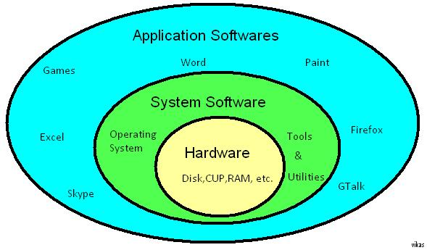
System programming
According to Computer Hierarchy, one which comes at last is Hardware. Then it is System Programs, and finally Application Programs.
System software serves as the interface between the hardware and the end users.

Slide 4
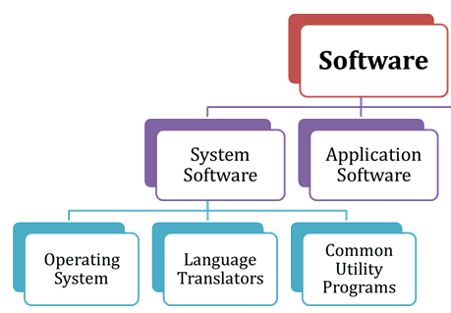
System programming
There are two main types of software: systems software and application software.
Systems software includes the programs that are dedicated to managing the computer itself.
Application Software is a set of programs that control and manage the operations of computer hardware. It also helps application programs to execute correctly.

Slide 5
System Programs
Various System Programs are :
Assemblers
Loaders
Linkers
Macro processor
Compiler
Interpreter
Operating System
Device drivers

Slide 6
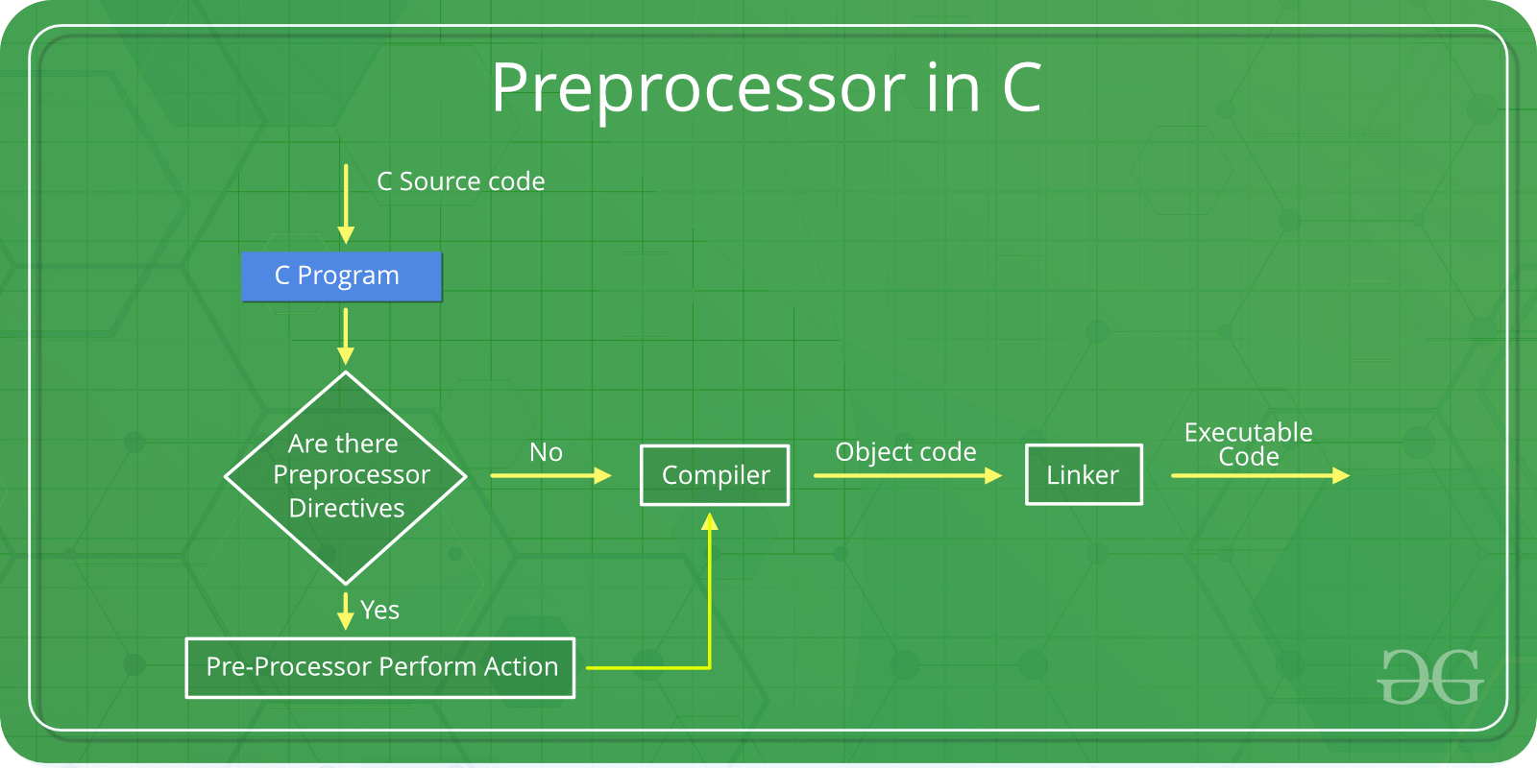
Macro Processors or Pre Processors
As the name suggests Preprocessors are programs that process our source code before compilation.

Slide 7
Macro Processors or Pre Processors
There are 4 main types of pre-processor directives:
Macros
File Inclusion
Conditional Compilation
Other directives

Slide 8
Macros
Macros are a piece of code in a program which is given some name.
Whenever this name is encountered by the compiler
The compiler replaces the name with the actual piece of code.
I.E. It replaces the name with the definition of the macro
The ‘#define’ directive is used to define a macro.
Macro definitions need not be terminated by semi-colon(;).

Slide 9
Macros
C program to illustrate macros
#include <stdio.h>
// Macro definition
#define LIMIT 5
int main()
{
// Print the value of macro defined
printf("The value of LIMIT is %d", LIMIT);
return 0;
}
Output-
The value of LIMIT is 5

Slide 10
File Inclusion
This type of preprocessor directive tells the compiler to include a file in the source code program.
There are two types of files which can be included by the user in the program:
Header File or Standard files
User defined files

Slide 11
File Inclusion
Header File or Standard files:
These files contains definition of pre-defined functions like printf(), scanf() etc. These files must be included for working with these functions.
Different function are declared in different header files.
For example C++ standard I/O functions are in ‘iostream’ header file whereas
Functions which perform string operations are in ‘string’ header file.

Slide 12
File Inclusion
Header File or Standard files:
Syntax: #include< file_name >
where file_name is the name of file to be included.
The ‘<‘ and ‘>’ brackets tells the compiler to look for the file in standard directory.

Slide 13
File Inclusion
User defined files:
When a program becomes very large, it is good practice to divide it into smaller files and include it whenever needed. These types of files are user defined files.
These files can be included as: #include"filename"

Slide 14
File Inclusion
#include<filename.h>
#include “filename.h”
By using this syntax, when we are including header file then it will be loaded from default directory i.e. C:\TC\INCLUDE.
Generally, by using this syntax we are including pre-defined header files.
Generally, by using this syntax we are including user-defined header files.
It is loaded from the current working directory.

Slide 15
Conditional Compilation Directives
Are type of directives which helps
To compile a specific portion of the program or
To skip compilation of some specific part of the program
Based on some conditions.
This can be done with the help of two preprocessing commands ‘ifdef‘ and ‘endif‘.

Slide 16
Conditional Compilation Directives
Syntax:
#ifdef macro_name
statement1;
statement2;
statement3;
.
.
.
statementN;
#endif
If the macro with name as ‘macroname‘ is defined
Then the block of statements will execute normally
Else the compiler will simply skip this block of statements.

Slide 17

Conditional Compilation Directives
#include <stdio.h>
#define YEARS_OLD 10
int main()
{
#ifdef YEARS_OLD
printf("TechOnTheNet is over %d years old.\n", YEARS_OLD);
#endif
printf("TechOnTheNet is a great resource.\n");
return 0;
}
In the C Programming Language, the #ifdef directive allows for conditional compilation.
The preprocessor determines if the provided macro exists before including the subsequent code in the compilation process.

Slide 18
Other directives
Apart from the above directives there are two more directives which are not commonly used.
These are:
#undef Directive
#pragma Directive

Slide 19
Other directives
#undef Directive:
The #undef directive is used to undefine an existing macro. This directive works as:
#undef LIMIT
Using this statement will undefine the existing macro LIMIT.
After this statement every “#ifdef LIMIT” statement will evaluate to false.
#pragma Directive:
This directive is a special purpose directive and is used to turn on or off some features.
This type of directives are compiler-specific, i.e., they vary from compiler to compiler.

Slide 20
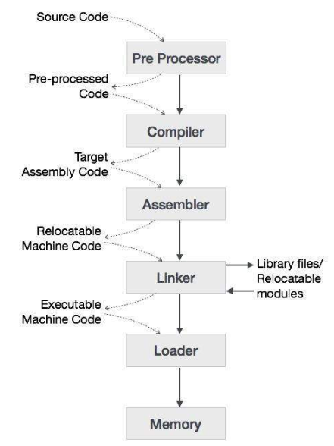
How a program, using C compiler, is executed on a host machine ?

Slide 21
How a program, using C compiler, is executed on a host machine ?
User writes a program in C language (high-level language).
The C compiler, compiles the program and translates it to assembly program.
An assembler then translates the assembly program into machine code (object file).
A linker tool is used to link all the parts of the program together for execution (executable machine code).
A loader loads all of them into memory and then the program is executed.

Slide 22
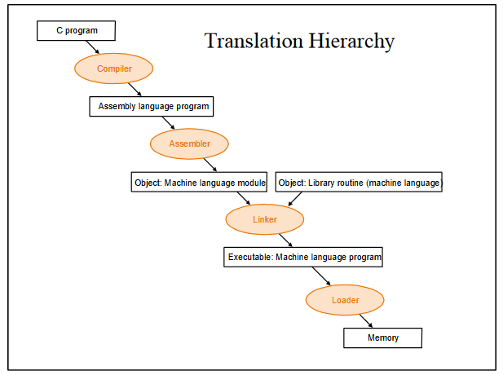

Slide 23
Compiler
A compiler is a software that
translates the code written in one language to some other language
without changing the meaning of the program.

Slide 24
Compiler
The compiler is also said to
make the target code efficient and
optimized in terms of time and space.
In this example , “C” compiler converts high-level language program into assembly language

Slide 25
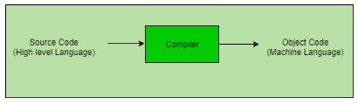
Compiler
The language processor that reads the complete source program written in high level language as a whole in one go and translates it into an equivalent program in machine language is called as a Compiler.

Slide 26
Compiler
In a compiler, the source code is translated to object code successfully if it is free of errors.
The compiler specifies
the errors at the end of compilation with line numbers when there are any errors in the source code.
The errors must be removed before the compiler can successfully recompile the source code again.

Slide 27
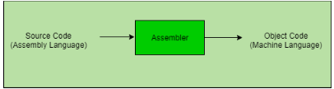
Assembler
A program that converts assembly language programs into object files

Slide 28
Assembler
The output of an assembler is called an object file
Object files contain a combination of
machine instructions,
data, and
information needed to place instructions properly in memory.

Slide 29

Object file format
Object file header describes the size and position of the other pieces of the file
Text segment contains the machine instructions
Data segment contains binary representation of data in assembly file
Relocation info identifies instructions and data that depend on absolute addresses
Symbol table associates addresses with external labels and lists unresolved references
Debugging info

Slide 30
Interpreter
An interpreter, like a compiler, translates high-level language into low-level machine language.

Slide 31
Interpreter
The difference lies in the way they read the source code or input.
A compiler reads the whole source code at once, creates tokens, checks semantics, generates intermediate code, executes the whole program and may involve many passes.
An interpreter reads a statement from the input, executes it, then takes the next statement in sequence.

Slide 32
Interpreter
If an error occurs,
an interpreter stops execution and reports it. The interpreter moves on to the next line for execution only after removal of the error.
whereas a compiler reads the whole program even if it encounters several errors.
Example: Perl, Python and Matlab.

Slide 33
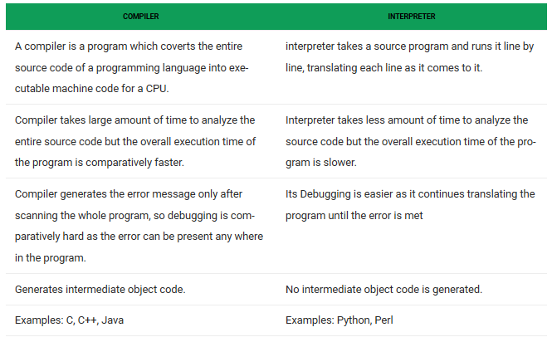

Slide 34
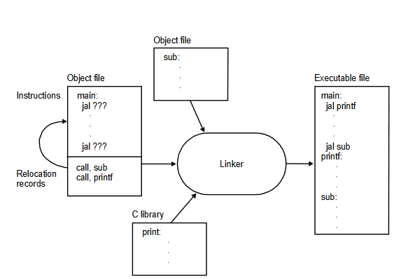
Linker

Slide 35
Linker
Tool that merges the object files produced by separate compilation or assembly and creates a single executable file
Linker are also called link editors.

Slide 36
Linker
A linker tool is used to link all the parts of the program together for execution (executable machine code).

Slide 37
EXTERN STORAGE CLASS
PGM1.CPP
#include<stdio.h>
#include "pgm2.cpp"
int i;
void show(void);
int main()
{
i=10;
show();
printf("\n Value of i in pgm1.cpp=%d",i);
return 0;
}
PGM2.CPP
extern int i;
void show()
{
printf("\n value of i in pgm2.cpp=%d",i);
}
OUTPUT??

Slide 38
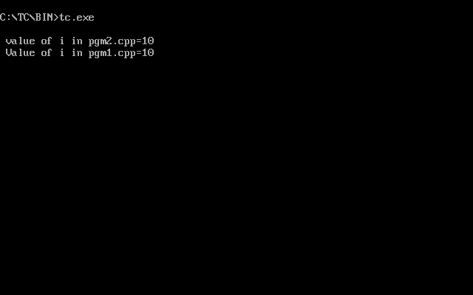
EXTERN STORAGE CLASS
PGM1.CPP
#include<stdio.h>
#include "pgm2.cpp"
int i;
void show(void);
int main()
{
i=10;
show();
printf("\n Value of i in pgm1.cpp=%d",i);
return 0;
}
PGM2.CPP
extern int i;
void show()
{
printf("\n value of i in pgm2.cpp=%d",i);
}
OUTPUT-

Slide 39
EXTERN STORAGE CLASS
File 1 (file.h)
extern int x = 10,y = 20;
File 2 (demo.c)
#include "file.h"
#include <stdio.h>
void main()
{
int add;
printf("x = %d \n",x);
printf("y = %d \n",y);
add=x+y;
printf("Add = %d \n",add);
}
OUTPUT??

Slide 40
EXTERN STORAGE CLASS
File 1 (file.h)
extern int x = 10,y = 20;
File 2 (demo.c)
#include "file.h"
#include <stdio.h>
void main()
{
int add;
printf("x = %d \n",x);
printf("y = %d \n",y);
add=x+y;
printf("Add = %d \n",add);
}
OUTPUT??

Slide 41
Linker
The major tasks–
To search and locate referenced routines in a program
Searches the program to find library routines used by program, e.g. printf(), math routines,...

Slide 42
Loader in C/C++
Loader is the program of the operating system
which loads the executable from the disk into the primary memory(RAM) for execution.
It allocates the memory space to the executable module in main memory and then transfers control to the beginning instruction of the program .

Slide 43
Loader in C/C++
It places programs into memory and prepares them for execution.
Loading a program involves reading the contents of the executable file containing the program instructions into memory,
Then carrying out other required preparatory tasks to prepare the executable for running.
Once loading is complete, the operating system starts the program by passing control to the loaded program code.
https://en.wikipedia.org/wiki/Loader_(computing)

Slide 44
Relocation
The available memory is generally shared among a number of processes in a multiprogramming system,
So it is not possible to know in advance which other programs will be resident in main memory at the time of execution of this program.
Swapping the active processes in and out of the main memory enables the operating system to have a larger pool of ready-to-execute process.
-GeeksforGeeks

Slide 45
Relocation
When a program gets swapped out to a disk memory, then it is not always possible that when it is swapped back into main memory then it occupies the previous memory location,
Since the location may still be occupied by another process.
We may need to relocate the process to a different area of memory. Thus there is a possibility that program may be moved in main memory due to swapping.
-GeeksforGeeks
https://www.geeksforgeeks.org/requirements-of-memory-management-system/

Slide 46
Relocation
Relocation is the process of assigning load addresses for position-dependent code and data of a program and adjusting the code and data to reflect the assigned addresses.
Relocation is typically done by the linker at link time, but it can also be done at load time by a relocating loader.
-Wikipedia

Slide 47
GATE CS 1998 | Question 25
In a resident- OS computer, which of the following system software must reside in the main memory under all situations? (A) Assembler (B) Linker (C) Loader (D) Compiler

Slide 48
GATE CS 1998 | Question 25
In a resident- OS computer, which of the following system software must reside in the main memory under all situations? (A) Assembler (B) Linker (C) Loader (D) Compiler Answer: (C) Explanation: Loader is the part of an operating system that is responsible for loading programs and libraries. it places the programs into memory and also prepares them for execution.
Loading a program involves tasks such as reading the contents of the executable file containing the program instructions into memory, and then carrying out other required preparatory tasks to prepare the executable for running so any software must reside in the main memory under all situations.
The operating system starts the program by passing control to the loaded program code once the loading process is completed.
Option (C) is correct.

Slide 49
Q) A linker program
a. places the program in the memory for the purpose of execution.
b. relocates the program to execute from the specific memory area allocated to it.
c. links the program with other programs needed for its execution.
d. interfaces the program with the entities generating its input data.

Slide 50
Q) A linker program
a. places the program in the memory for the purpose of execution.
b. relocates the program to execute from the specific memory area allocated to it.
c. links the program with other programs needed for its execution.
d. interfaces the program with the entities generating its input data.
Ans) c)

Slide 51
What is an Operating System?

Slide 52
What is an Operating System?
A program that acts as an intermediary between a user of a computer and the computer hardware.
Provides an environment in which a user can execute programs in a convenient and efficient manner.

Slide 53
What is an Operating System?
Operating system goals:
Execute user programs and make solving user problems easier
Make the computer system convenient to use
Use the computer hardware in an efficient manner

Slide 54

Four Components of a Computer System

Slide 55
Computer System Structure
Computer system can be divided into four components:
Hardware
Operating system
System & Application programs
Users

Slide 56
Computer System Structure
Hardware – provides basic computing resources
CPU,
memory,
I/O devices
Operating system
Controls and
Coordinates use of hardware among various applications and users

Slide 57
Computer System Structure
Application programs
define the ways in which the system resources are used
to solve the computing problems of the users
Word processors,
web browsers,
database systems,
video games
Users
People, machines, other computers

Slide 58
Four Components of a Computer System
OS controls and coordinates the use of hardware among the various application programs for the various users.

Slide 59
Evolution of Operating System
Mainframe System
Batch Systems
Multiprogrammed Systems
Time Sharing Systems
Desktop Systems
Multiprocessor Systems
Symmetric Multiprocessor
Asymmetric Multiprocessor
Distributed Systems
Client Server Systems
Peer to Peer Systems
Clustered Systems
Asymmetric clustering
Symmetric clustering
Real Systems
Hard Real Time System
Soft Real Time System
HandHeld Systems

Slide 60
Mainframe System
First computers to tackle commercial and scientific applications.
Growth from Batch systems to Multi-programmed to Timesharing(Multitasking system)

Slide 61

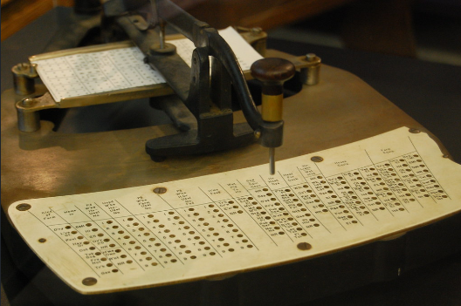
??

Slide 62
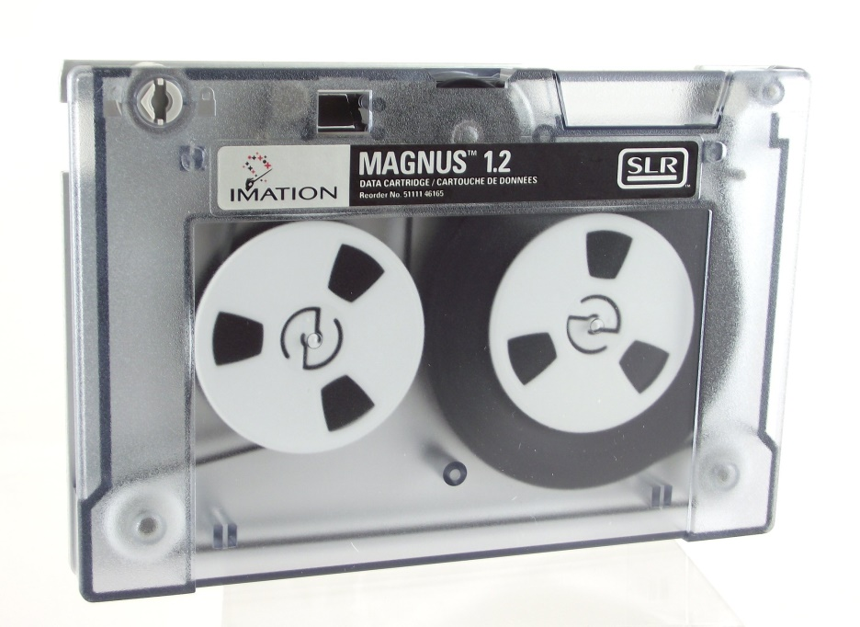
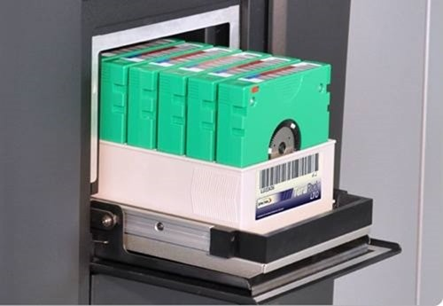
??

Slide 63
Batch system
Early computers were physically enormous machines run from a console.
Input devices –
Card readers and
Tape drivers.
O/P devices-
Line printers,
Tape drivers,
Card Punches.

Slide 64
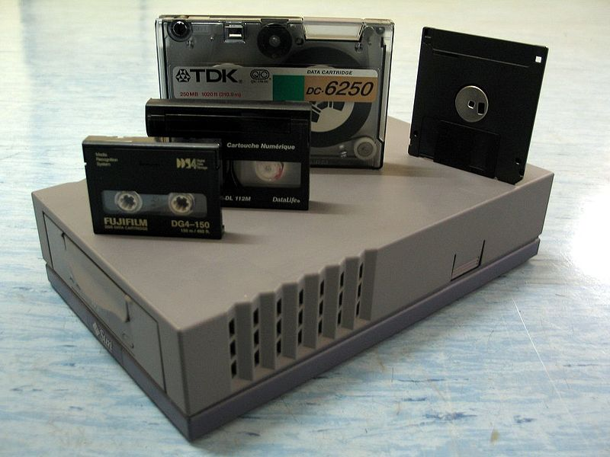
Tape drives
A tape drive is a data storage device that reads and writes data on a magnetic tape.
Magnetic tape data storage is typically used for offline, archival data storage.
Tape media generally has a favourable unit cost and a long archival stability.
Magnetic tapes are typically placed in plastic covers referred to as cassettes.

Slide 65
Tape drives
A tape drive provides sequential access storage, unlike a hard disk drive, which provides direct access storage.
A disk drive can move to any position on the disk in a few milliseconds,
but a tape drive must physically wind tape between reels to read any one particular piece of data.
As a result, tape drives have very large average access times.
However, tape drives can stream data very quickly off a tape when the required position has been reached.

Slide 66
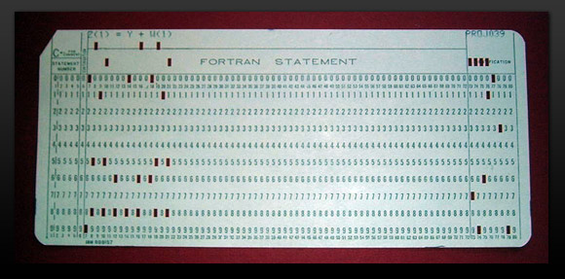
Punch card/A punched card
Is a piece of stiff paper that can be used to contain digital data
represented by the presence or absence of holes in predefined positions.
Punched cards were widely used through much of the 20th century for
data input, output, and storage.
Card from a Fortran program

Slide 67
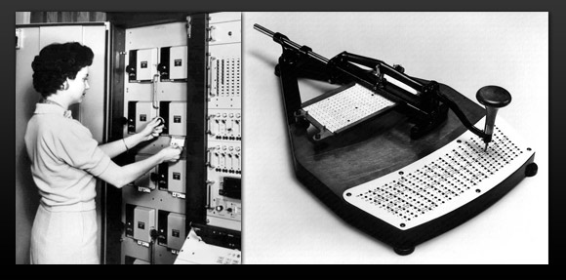
Punch card/A punched card
Many early digital computers used punched cards for input of both
computer programs and
data.
While punched cards are now obsolete as a storage medium, as of 2012, some voting machines still use punched cards to record votes.
Above left: Punch card reader.
Above right: Punch card writer.

Slide 68
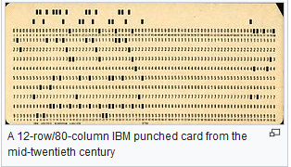
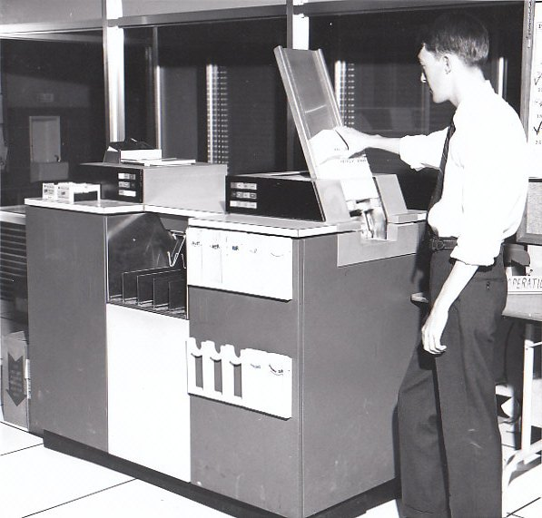
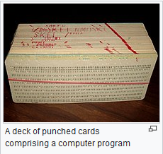
Punch card Reader, A punched card
Card reader/punch
Courtesy :https://www.ibiblio.org/comphist/node/57,https://en.wikipedia.org/wiki/Punched_card

Slide 69
Batch system
User did not interact with the computer systems.
User prepared a job which consisted of
the programs,
data and
control information ,
submitted it to the computer operator.
The job was usually in the form of punch cards.
At some later time, the output appeared.
The o/p consisted of
result of the program, as well as
a dump of the final memory and
register contents for debugging.

Slide 70
Batch system
To speed up processing,
operators batched together jobs with similar needs and
ran them throughout the computer as a group.

Slide 71
Batch system
The programmers would leave their programs with the operator.
The operator would
sort programs into batches with similar requirements and
would run each batch as the computer became available.
The O/P would be sent back to the appropriate programmer

Slide 72
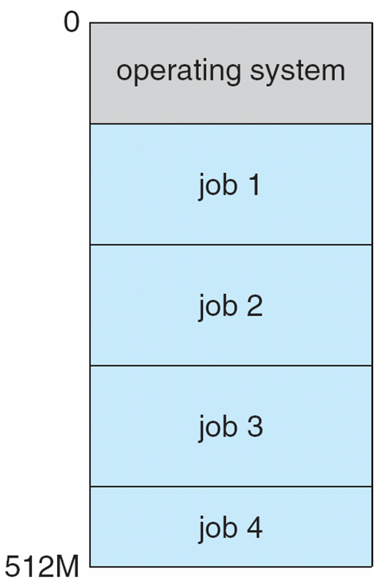
Memory Layout for Multiprogrammed System
Bring multiple programs in RAM
Now,
How to execute these programs?

Slide 73
Non-multi programmed system
Non-multi programmed system’s working –
As soon as one job leaves the CPU and goes for I/O task the CPU becomes idle.
The CPU keeps waiting and waiting until this job (which was executing earlier) comes back and resumes its execution with the CPU. So CPU remains free for all this while.
Now it has a drawback that the CPU remains idle for a very long period of time. Also, other jobs which are waiting to be executed might not get a chance to execute because the CPU is still allocated to the earlier job.

Slide 74
Multiprogramming
Multi programmed system’s working –
In a multi-programmed system, as soon as one job goes for an I/O task, the Operating System interrupts that job, chooses another job from the job pool, gives CPU to this new job and starts its execution.
The previous job keeps doing its I/O operation while this new job does CPU bound tasks.
Now say the second job also goes for an I/O task, the CPU chooses a third job and starts executing it.

Slide 75
Multiprogramming
Multiprogramming needed for efficiency
Single Program cannot keep CPU and I/O devices busy at all times
Multiprogramming increases CPU utilization by organizing jobs (code and data) so that CPU always has one to execute.
A subset of total jobs in system is kept in memory
One job selected and run via job scheduling
When it has to wait for some task, such as I/O, OS switches to another job
In non- multiprogrammed system, The CPU would sit idle.

Slide 76
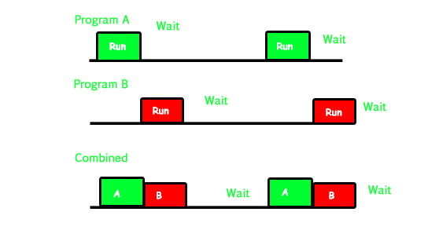
Multiprogramming
Program A runs for some time and then goes to waiting state. In the mean time program B begins its execution.
So the CPU does not waste its resources and gives program B an opportunity to run.

Slide 77
Drawbacks
Multiprogrammed ,batched system provided an environment
where the various system resources were utilized effectively,
but it did not provide for user interaction with the computer system.

Slide 78
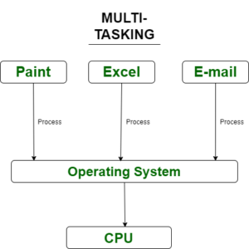
Timesharing (multitasking)
Timesharing (multitasking) is logical extension of multiprogramming
CPU switches jobs so frequently that users can interact with each job while it is running, creating interactive computing.
-Galvin
CPU executes multiple jobs by switching among them typically using a small time quantum
The switches occur so frequently that the users can interact with each program while it is running.
- GeeksforGeeks
https://www.geeksforgeeks.org/difference-between-multiprogramming-and-multitasking/

Slide 79
Timesharing (multitasking)
An interactive computer system provides direct communication between the user and the system.
Response time should be short , < 1 second
Each user has at least one program executing in memory process
If several jobs ready to run at the same time  CPU scheduling
If processes don’t fit in memory, swapping moves them in and out to run
Virtual memory allows execution of processes not completely in memory

Slide 80
Multiprogramming
Multi programmed –Non-Preemptive?
Multitasking-Preemptive?

Slide 81
Multiprogramming
Class-Student Example?
S1
S2
S3
S4
S5
S6
S7
S8
S9
S10

Slide 82
Multitasking
Class-Student Example?
S1
S2
S3
S4
S5
S6
S7
S8
S9
S10

Slide 83
Timesharing (multitasking)
More complex than Multi programmed OS

Slide 84
Timesharing (multitasking)
To obtain a reasonable response time,
jobs may have to be swapped in and out of main memory to the disk.
Virtual memory is used
which allows execution of a job that may not be completely in memory.
Programs can be longer than physical memory.

Slide 85
Timesharing (multitasking)
In a time sharing system, each process is assigned some specific quantum of time for which a process is meant to execute.
Say there are 4 processes P1, P2, P3, P4 ready to execute.
Say time quantum of 5 nanoseconds (5 ns).
As one process begins execution (say P2), it executes for that quantum of time (5 ns).
After 5 ns the CPU starts the execution of the other process (say P3) for the specified quantum of time.

Slide 86
Timesharing (multitasking)
Thus the CPU makes the processes to share time slices between them and execute accordingly.
As soon as time quantum of one process expires, another process begins its execution.
The context switch is so fast that the user is able to interact with each program separately while it is running.
This way, the user is given the illusion that multiple processes/ tasks are executing simultaneously.

Slide 87
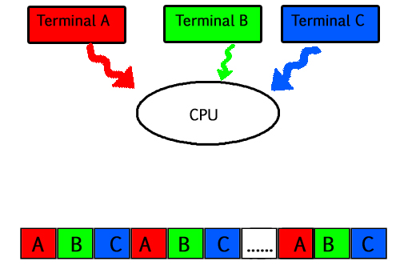
Timesharing (multitasking)
So for multitasking to take place, firstly there should be multiprogramming i.e. presence of multiple programs ready for execution.
And secondly the concept of time sharing.
Responsiveness Increases

Slide 88
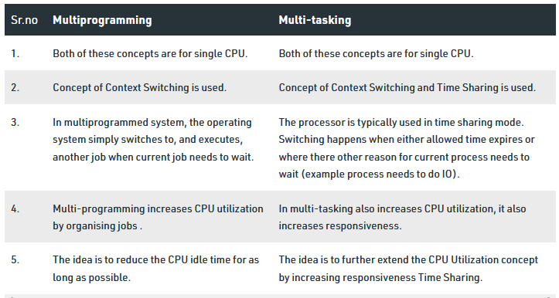


Multiprogramming Vs Timesharing (multitasking)
https://www.geeksforgeeks.org/difference-between-multiprogramming-and-multitasking/

Slide 89
ISRO | ISRO CS 2007 | Question 25
What is the name of the technique in which the operating system of a computer executes several programs concurrently by switching back and forth between them? (A) Partitioning (B) Multi-tasking (C) Windowing (D) Paging

Slide 90
ISRO | ISRO CS 2007 | Question 25
What is the name of the technique in which the operating system of a computer executes several programs concurrently by switching back and forth between them? (A) Partitioning (B) Multi-tasking (C) Windowing (D) Paging Answer: (B) Explanation: In a multitasking system, a computer executes several programs simultaneously by switching them back and forth to increase the user interactivity. Processes share the CPU and execute in an interleaving manner. This allows the user to run more than one program at a time.

Slide 91
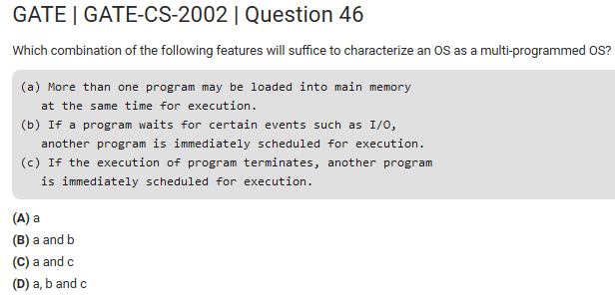

Slide 92
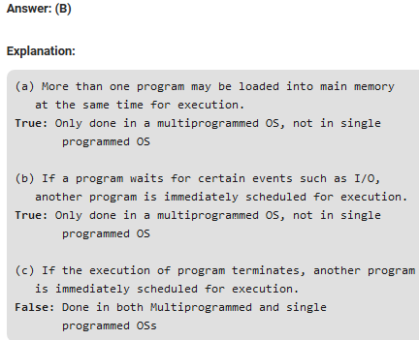

Slide 93
Multiprocessor Systems
Also called Parallel System or Tightly coupled System grew in importance.
More than one processor in close communication, sharing
the computer bus,
the clock and
sometimes memory and peripheral devices.

Slide 94
Multiprocessor Systems
Advantages:-
Increased Throughput
Economy of scale
Increased Reliability

Slide 95
Multiprocessor Systems
Advantages:-
Increased Throughput
To Get more work done.
The speedup ratio with N processors is not N, it is less than N.
Overhead is incurred in keeping all parts working correctly.
Plus Contention for shared resources lowers the expected gains.

Slide 96
Multiprocessor Systems
Advantages:-
Economy of scale
Save more money as they share
peripherals,
mass storage,
power supplies.

Slide 97
Multiprocessor Systems
Advantages:-
Increased Reliability
If functions can be distributed properly among several processors, then
the failure of one processor will not halt the system,
only slow it down.

Slide 98
Multiprocessor Systems
Symmetric Multiprocessor
Each processor runs an identical copy of the OS and
These copies communicate with one another as needed.
Asymmetric Multiprocessor
Each processor is assigned a specific task.
A master processor controls the system,
The other processor either look to the master for instruction or have predefined tasks.
The master allocates the work to the slave processor.

Slide 99
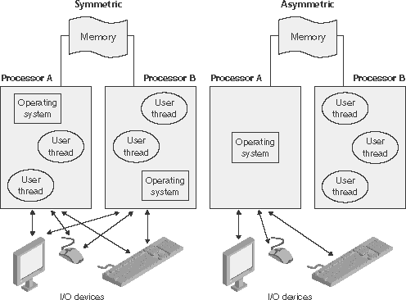
Asymmetric multiprocessing
ASMP
The operating system typically sets aside one or more processors for its exclusive use.
The remainder of the processors run user applications.

Slide 100
Asymmetric multiprocessing
In the ASMP model,
If the processor that fails is an operating system processor,
The whole computer can go down.

Slide 101
Symmetric Multiprocessing
Symmetric multiprocessing (SMP) technology is used to get higher levels of performance.
In symmetric multiprocessing, any processor can run any type of thread. The processors communicate with each other through shared memory.
SMP systems provide better load-balancing and fault tolerance.

Slide 102
Symmetric Multiprocessing
Because the operating system threads can run on any processor, the chance of hitting a CPU bottleneck is greatly reduced.
All processors are allowed to run a mixture of application and operating system code.
A processor failure in the SMP model only reduces the computing capacity of the system.

Slide 103
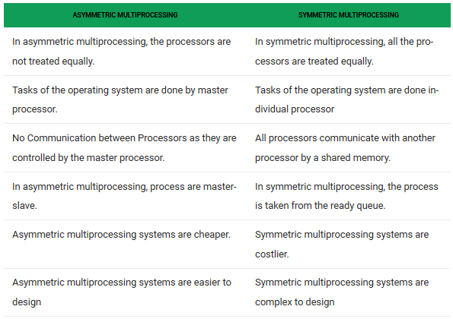
Difference Between Asymmetric and Symmetric Multiprocessing:

Slide 104
Multiprocessor Systems
Distributed Systems
Tightly coupled System
More than one processor in close communication
Sharing the computer bus, the clock and sometimes memory and peripheral devices.
Loosely Coupled Systems
Collection of processors
Do not share memory or a clock.
Each processor has its own local memory.
The processors communicate with one another through various communication lines such as high speed buses or telephone lines.

Slide 105
Distributed Systems
Collection of separate, possibly heterogeneous, systems networked together
Network is a communications path,
TCP/IP most common network protocol
Most OS support TCP/IP including the Windows and UNIX OS.

Slide 106
Networks
Networks are typecast based on the distances between their nodes
Personal Area Network (PAN)
Local Area Network (LAN)
Metropolitan Area Network (MAN)
Wide Area Network (WAN)

Slide 107
Networks
Networks are typecast based on the distances between their nodes
Personal Area Network (PAN)-Short distance of several feet like Bluetooth Devices
Local Area Network (LAN)- within a room, a floor, or a building
Metropolitan Area Network (MAN)-link building within a city
Wide Area Network (WAN)- exists between buildings, cities or countries

Slide 108
Distributed Systems
Types
Client-Server Systems
Peer-to-Peer Systems

Slide 109
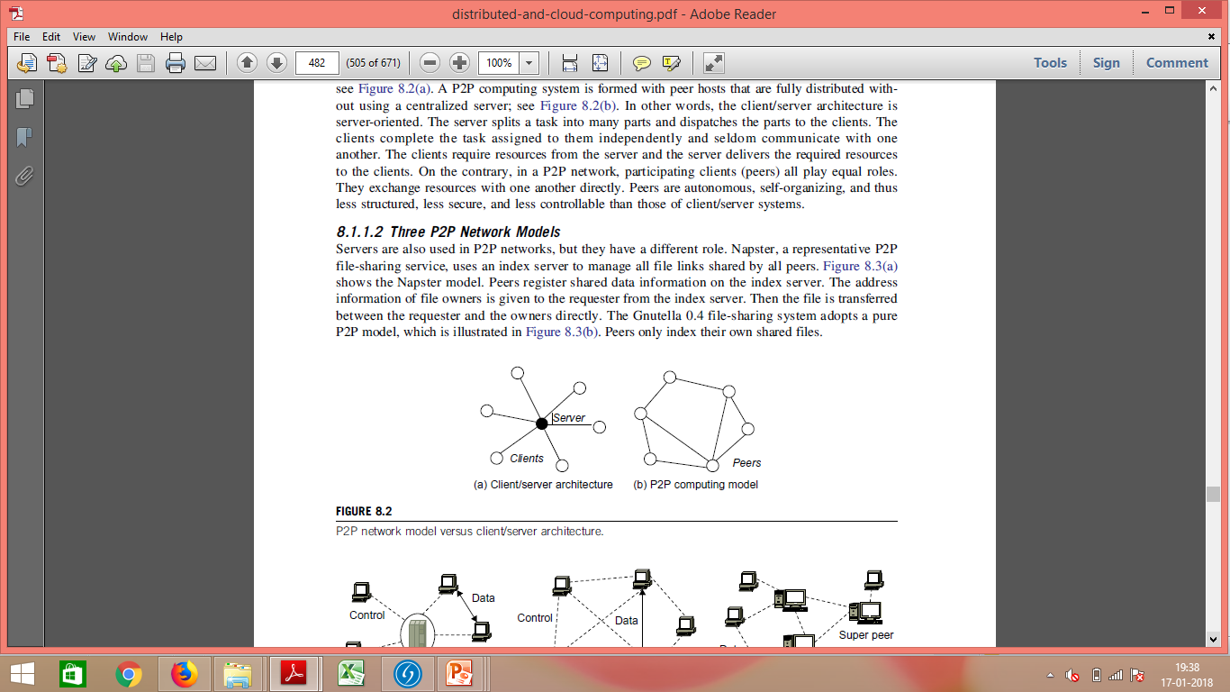
Client-Server Systems
Client-Server Computing
Centralized system act as server systems to satisfy requests generated by client systems
User interface handled by smart PCs.

Slide 110
Client-Server Systems
Server systems can be categorized as :
Compute-server system provides an interface to client to request services (i.e., database), perform action, send back results to the client
File-server system provides file system interface for clients to store and retrieve files i.e. create, update, read and delete files

Slide 111
P2P Networks
An alternative to the traditional client / server architecture where there typically is a single server and many clients.

Slide 112
Peer-to-Peer
Another model of distributed system
P2P does not distinguish clients and servers
All nodes are considered peers
Why Peers?

Slide 113
Peer-to-Peer
Why Peers?
“A communications model in which each party has the same capabilities and
All play equal roles.
Each node may act as client, server or both
No peer has global view of the entire system.

Slide 114
P2P Networks
Peers-
Exchange resources with one another directly.
Either party can initiate a communication session”

Slide 115
P2P Networks
P2P Networks are autonomous and self-organised with free participation from peers.
A P2P computing system is formed with peer hosts that are fully distributed without using a centralized server.

Slide 116
Peer-to-Peer
Node must join P2P network
Registers its service with central lookup service on network, or
Broadcast request for service and respond to requests for service via discovery protocol
Examples such as Skype

Slide 117
P2P Networks
Used widely in
Messaging,
Online Chatting,
Video streaming and
Social networking.

Slide 118
Peer-to-peer networking with BitTorrent
BitTorrent is by far
the most popular peer-to-peer programs ever.
??

Slide 119
Peer-to-peer networking with BitTorrent
BitTorrent is one of the most common protocols
for transferring large files,
such as digital video files containing TV shows or video clips or digital audio files containing songs.

Slide 120
BitTorrent Clients
To send or receive files,
a person uses a BitTorrent client on their Internet-connected computer.
A BitTorrent client is a
computer program that implements the BitTorrent protocol.
Popular clients include
μTorrent, Xunlei, Transmission, qBittorrent, Vuze, Deluge, BitComet and Tixati.

Slide 121




BitTorrent Clients
FrostWire
µTorrent
Tonido
Deluge

Slide 122
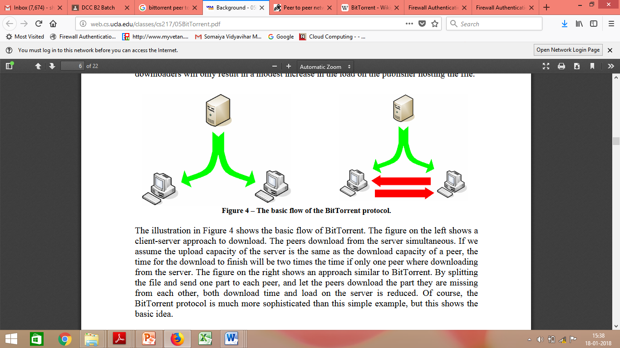
Typical Client Server
Downloading File from the server
P2P??

Slide 123
Typical Client Server
In the figure, The time for the download to finish will be two times the time if only one peer was downloading from the server.

Slide 124
Basic Idea behind BitTorrent
Student Answersheets ??

Slide 125
Basic Idea behind BitTorrent
The figure on the right shows an approach similar to BitTorrent.
By splitting the file
Send one part to each peer,
Let the peers download the part they are missing from each other,
Both download time and load on the server is reduced.
Of course, the BitTorrent protocol is much more sophisticated than this simple example, but this shows the basic idea.

Slide 126
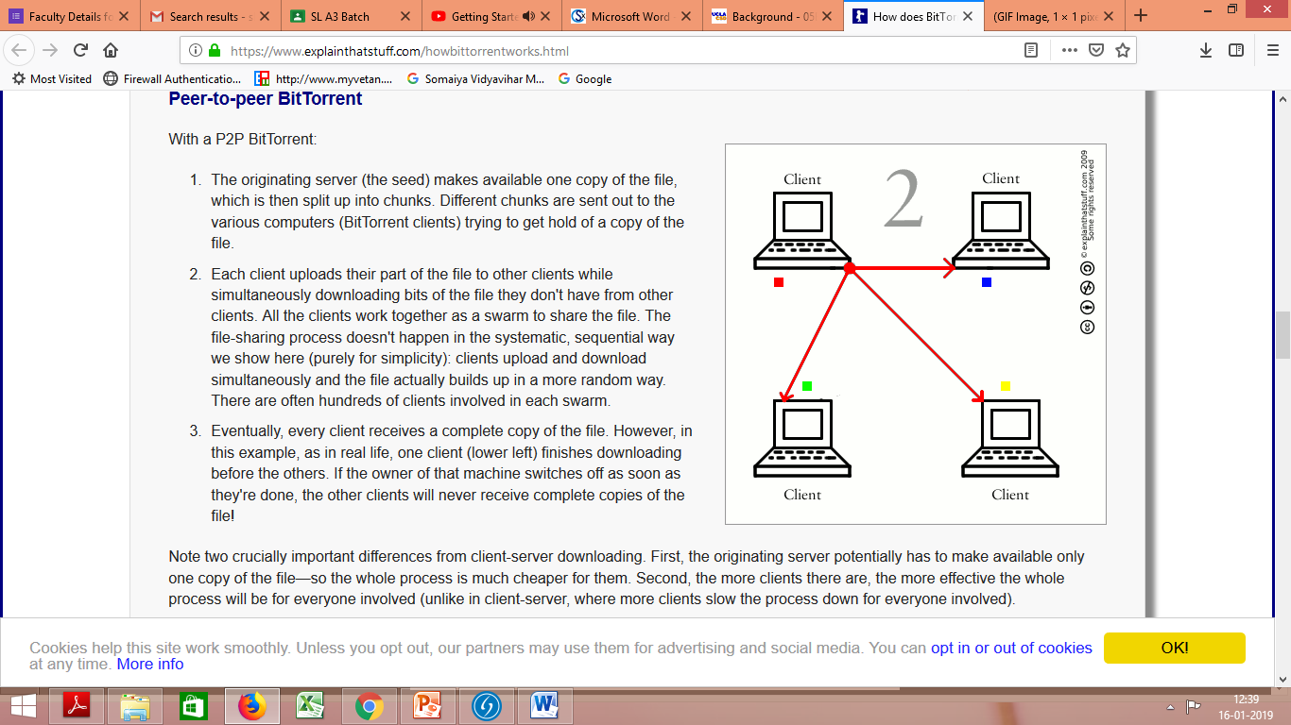
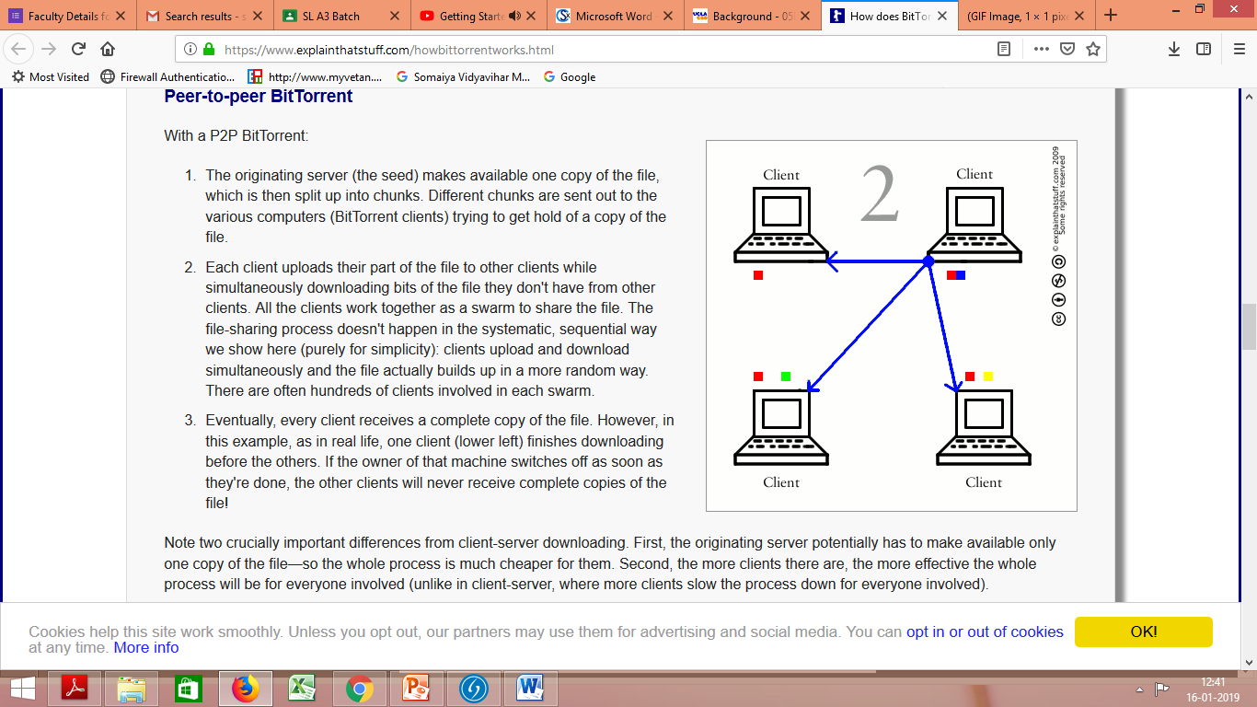
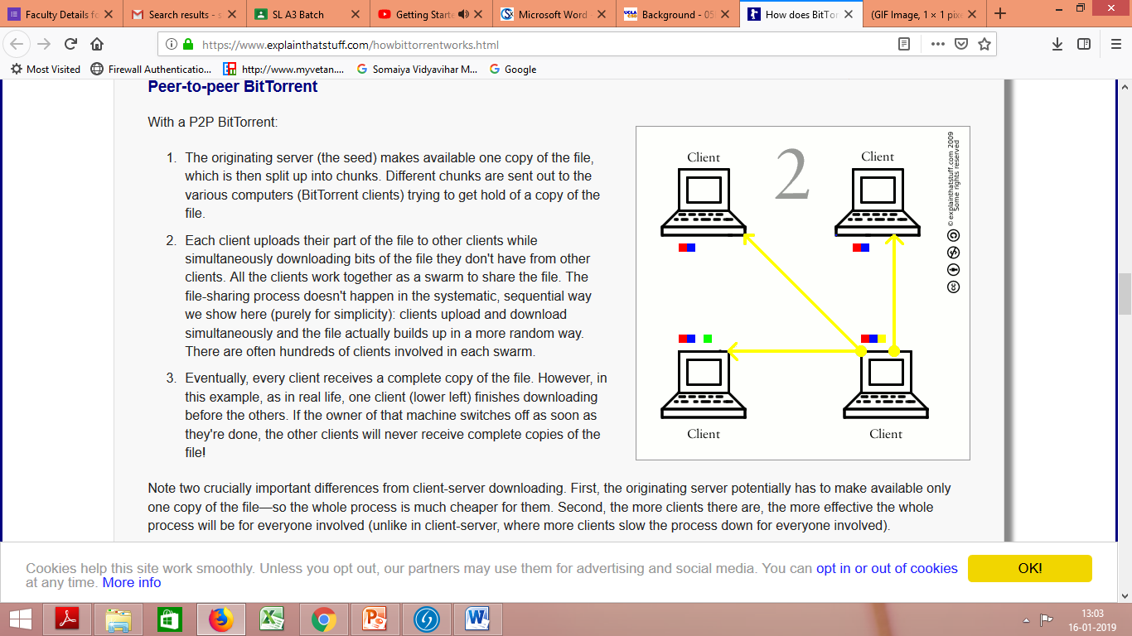
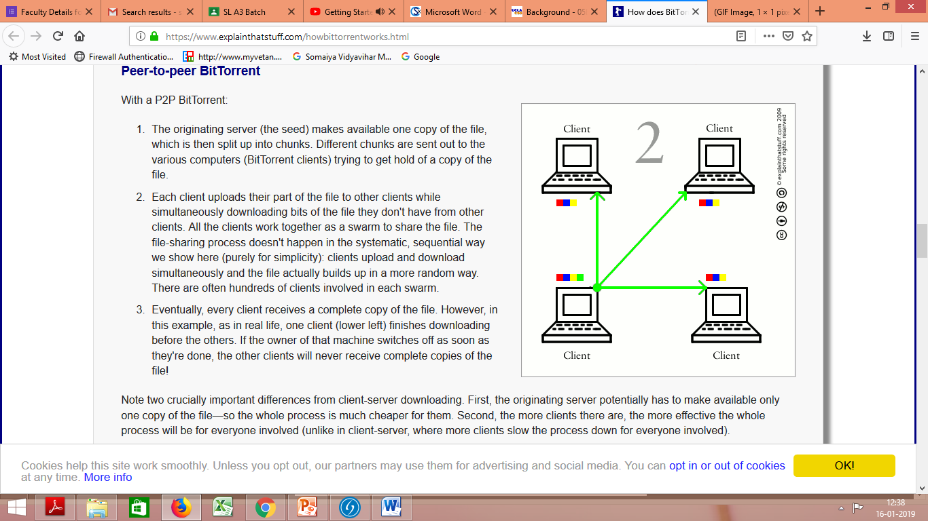
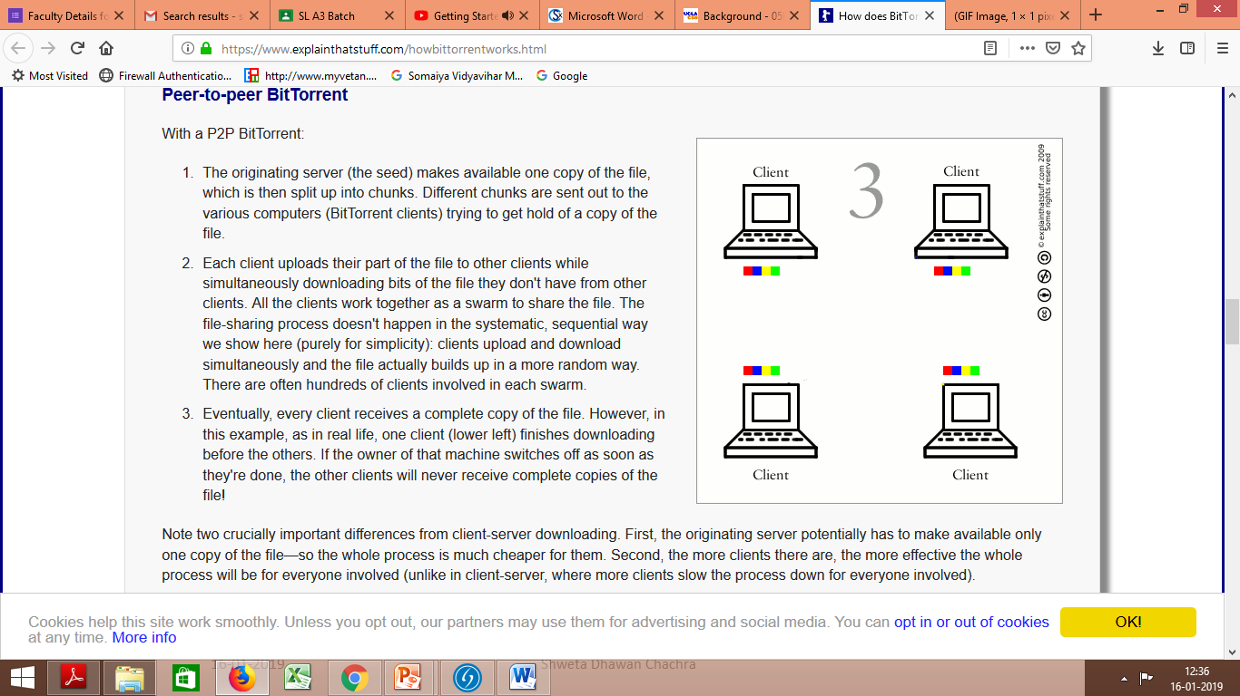

Slide 127
Real Time Systems
Special purpose OS
Used when rigid time requirements have been placed on the processing.
Often used as control device in Dedicated applications.

Slide 128
Real Time Systems
Real-time operating systems (RTOS) are used in environments where a large number of events, mostly external to the computer system, must be accepted and processed in a short time or within certain deadlines.

Slide 129
Real Time Systems
Examples of the real-time operating systems:
Satellite launch system
Railway signalling system
Airline traffic control systems,
Command Control Systems,
Industrial control,
Telephone switching equipment,
Flight control, and
Real-time simulations.

Slide 130
Real Time Systems
Real Time Systems functions correctly only if it returns the correct result within its time constraints.
In Contrast-
Time Sharing Systems, where it is desirable but not mandatory to respond quickly.
Batch System, which may have no time constraints at all.

Slide 131
Real Time Systems
Two types of Real-Time Operating System which are as follows:
Hard Real-Time Systems
Soft Real-Time Systems

Slide 132
Hard Real-Time Systems:
Soft Real-Time Systems:
These OSs are meant for the applications where time constraints are very strict and even the shortest possible delay is not acceptable.
These systems are built for saving life like automatic parachutes or air bags which are required to be readily available in case of any accident.
These OSs are for applications where for time-constraint is less strict.

Slide 133
Hard Real-Time Systems:
Soft Real-Time Systems:
This type of system can miss its deadline occasionally with some acceptably low probability.
Missing the deadline have no disastrous consequences.
This type of system can never miss its deadline.
Missing the deadline may have disastrous consequences.

Slide 134
Hard Real-Time Systems:
Soft Real-Time Systems:
The usefulness of result produced by a hard real time system decreases abruptly if tardiness increases.
Examples:
Satellite launch system
Railway signalling system
Airline traffic control systems
Command Control Systems
The usefulness of result produced by a soft real time system decreases gradually with increase in tardiness.
Examples:
Telephone switches.
Multimedia Transmission and Reception
DVD Player
Web browsing
Gaming-Computer Games
Tardiness - How late a real time system completes its task with respect to its deadline.

Slide 135
HRTS- Healthcare and Patient Monitoring
How quickly data is processed in healthcare can often mean the difference between life and death.
Real-time systems are key to ensuring data from patient monitoring systems, such as heart rate monitors, is available to clinicians when and where they need it to keep patients safe and healthy.

Slide 136
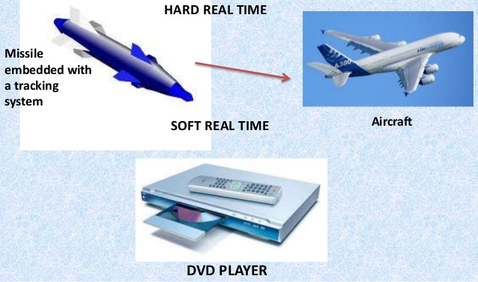
RTS

Slide 137
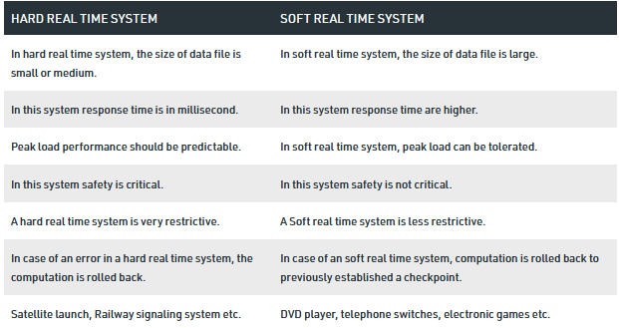



Slide 138
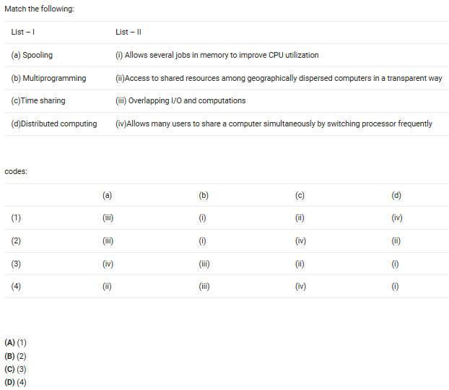

Slide 139
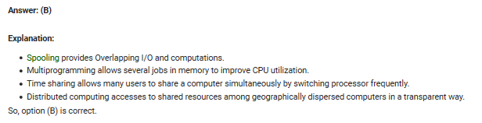

Slide 140
SPOOL is an acronym for simultaneous peripheral operations on-line.
A large buffer from hard disk
Buffer can store the data through I/O
Because I/O is slow and CPU is fast.
In a computer system peripheral equipments, such as printers and punch card readers etc (batch processing), are very slow relative to the performance of the rest of the system.

Slide 141
SPOOL is an acronym for simultaneous peripheral operations on-line.
In computing, spooling is a specialized form of multi-programming for the purpose of copying data between different devices
It is usually used for mediating between a computer application and a slow peripheral, such as a printer.
A dedicated program, the spooler, maintains an orderly sequence of jobs for the peripheral and feeds it data at its own rate.

Slide 142
ISRO | ISRO CS 2017 – May | Question 71
Which of the following statement is true?
(A) Hard real time OS has less jitter than soft real time OS (B) Hard real time OS has more jitter than soft real time OS (C) Hard real time OS has equal jitter as soft real time OS (D) None of the above

Slide 143
ISRO | ISRO CS 2017 – May | Question 71
Which of the following statement is true? (A) Hard real time OS has less jitter than soft real time OS (B) Hard real time OS has more jitter than soft real time OS (C) Hard real time OS has equal jitter as soft real time OS (D) None of the above Answer: (A) Explanation: Jitter is the variation / displacement between the signals or data being sent.
Hard real operating systems deal with more sensitive systems which require strict time deadlines like engine control systems, satellite launching systems etc while soft real operating systems do not require strict timing constraints and a bit delay is permissible, like mobile phones, online database systems. So hard real operating systems require minimised jitter.

Slide 144
ISRO | ISRO CS 2008 | Question 51
What is the name of the operating system that reads and reacts in terms of actual time.
A. Batch system
B. Quick response system
C. Real time system
D. Time sharing system

Slide 145
ISRO | ISRO CS 2008 | Question 51
What is the name of the operating system that reads and reacts in terms of actual time.
A. Batch system
B. Quick response system
C. Real time system
D. Time sharing system
Answer: (C) Explanation: A real-time operating system is an operating system that guarantees to process events or data by a specific moment in time.
Option (C) is correct.

Slide 146
Clustered Systems
Like multiprocessor systems, but multiple systems working together Usually sharing storage via a storage-area network (SAN)

Slide 147
Clustered Systems
Provides a high-availability service which survives failures
Clusters are used for high-performance computing (HPC)
Applications must be written to use parallelization
Some have distributed lock manager (DLM) to avoid conflicting operations

Slide 148
Cluster for Massive Parallelism
A collection of
interconnected stand alone computers
which can work together collectively and
cooperatively as a single integrated computing resource pool.
Deployed to
improve speed and/or reliability over that provided by a single computer, while
being much more cost effective than single computer of comparable speed or reliability

Slide 149
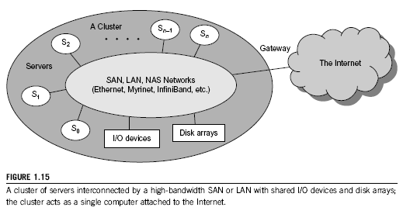
Cluster Architecture
Through hierarchical construction using a SAN, LAN or WAN, one can build scalable clusters with an increasing number of nodes.
The cluster is connected to the internet via a virtual private network(VPN) gateway.

Slide 150
Single System Image
An ideal cluster should merge multiple system images into a single system image(SSI).
Cluster designers desire a cluster operating system to support SSI at various levels, including the sharing of CPUs, memory and I/O across all cluster nodes.
SSI is an illusion created by software or hardware that presents a collection of resources as one integrated, powerful resource.
SSI makes the cluster appear like a single machine to the user.

Slide 151
SSI
Suppose a workstation has:
A 300 Mflops/second processor
512 MB of memory
4 GB disk
Support 50 active users and 1,000 processes.
By clustering 100 such workstations, we should get a single system that is equivalent to one huge workstation, or a megastation, that has:
30 Gflops/second processor
50 GB of memory
400 GB disk
Support 5,000 active users and 100,000 processes
This is an appealing goal, but it is very difficult to achieve.
SSI techniques are aimed at achieving this goal.

Slide 152
Asymmetric clustering has one machine in hot-standby mode
Symmetric clustering has multiple nodes running applications, monitoring each other

Slide 153
Clustered Systems
Asymmetric clustering-
One m/c is in hot standby mode while the other (primary node ) is running applications.
The hot standby host does nothing but monitor the active server.
If that server fails, the hot standby host becomes the active server.
The standby node is powered on (hot) and runs some monitoring programs to communicate heartbeat signals to check the status of the primary node, but is not actively running other useful workloads.

Slide 154
Clustered Systems
Symmetric clustering-
Two or more hosts are running applications and they are monitoring each other.
More efficient, as it uses all of the available hardware.

Slide 155
OS Objectives/Operations
Process Management Activities
Memory Management
Storage Management
Mass-Storage Management
Protection System

Slide 156
Process Management Activities
The operating system is responsible for the following activities in connection with process management:
Creating and deleting both user and system processes
Suspending and resuming processes
Providing mechanisms for process synchronization
Providing mechanisms for process communication
Providing mechanisms for deadlock handling

Slide 157
Memory Management
To execute a program
All (or part) of the instructions must be in memory
All (or part) of the data that is needed by the program must be in memory.
Memory management determines what is in memory and when
Optimizing CPU utilization and computer response to users

Slide 158
Memory Management
Memory management activities
Keeping track of the parts of memory are currently being used and by whom
Deciding which processes (or parts thereof) and data to move into and out of memory
Allocating and deallocating memory space as needed

Slide 159
Storage Management
OS provides uniform, logical view of information storage
Abstracts physical properties to logical storage unit - file
Each medium is controlled by device (i.e., disk drive, tape drive)
Varying properties include
access speed,
capacity,
data-transfer rate,
access method (sequential or random)

Slide 160
File System Storage Management
File-System management
Files usually organized into directories
Access control on most systems to determine who can access what
OS activities include
Creating and deleting files and directories
Primitives to manipulate files and directories
Mapping files onto secondary storage
Backup files onto stable (non-volatile) storage media

Slide 161
Mass-Storage Management
Usually disks used to store
data that does not fit in main memory or
data that must be kept for a “long” period of time
Entire speed of computer operation hinges on disk subsystem and its algorithms
OS activities
Free-space management
Storage allocation
Disk scheduling

Slide 162
Mass-Storage Management
Some storage need not be fast
Tertiary storage includes optical storage, magnetic tape
Still must be managed – by OS or applications
Varies between WORM (write-once, read-many-times) and RW (read-write)

Slide 163
Performance of Various Levels of Storage
Movement between levels of storage hierarchy can be explicit or implicit

Slide 164
Protection and Security
Protection – any mechanism for controlling access of processes or users to resources defined by the OS
Security – defense of the system against internal and external attacks
Huge range, including
denial-of-service,
worms,
viruses,
identity theft,
theft of service

Slide 165
Protection and Security
Systems generally first distinguish among users, to determine who can do what
User identities (user IDs, security IDs) include name and associated number, one per user
User ID then associated with all files, processes of that user to determine access control
Group identifier (group ID) allows set of users to be defined and controls managed, then also associated with each process, file
Privilege escalation allows user to change to effective ID with more rights

Slide 166
Protection and Security
A mechanism that ensures that the files, memory segments, CPU and other resources
can be operated on by only those processes that have gained proper authorization from the OS.

Slide 167
Operating System Functions/Services
One set of operating-system services provides functionalities that are helpful to the user:
User interface - Almost all operating systems have a user interface (UI).
Varies between Command-Line (CLI), Graphics User Interface (GUI), Batch
Program execution - The system must be able to load a program into memory and to run that program, end execution, either normally or abnormally (indicating error)
I/O operations - A running program may require I/O, which may involve a file or an I/O device

Slide 168
Operating System Functions/Services (Cont.)
One set of operating-system services provides functions that are helpful to the user (Cont.):
File-system manipulation –
Programs need to
read and write files and directories,
create and delete them,
search them,
list file Information,
permission management.

Slide 169
Operating System Functions/Services (Cont.)
One set of operating-system services provides functions that are helpful to the user (Cont.):
Communications –
Processes may exchange information,
on the same computer or
between computers over a network
Communications may be via
shared memory or
through message passing (packets moved by the OS)

Slide 170
Operating System Functions/Services (Cont.)
One set of operating-system services provides functions that are helpful to the user (Cont.):
Error detection – OS needs to be constantly aware of possible errors
May occur in the CPU and memory hardware, in I/O devices, in user program
For each type of error, OS should take the appropriate action to ensure correct and consistent computing
Debugging facilities

Slide 171
Operating System Functions/Services (Cont.)
Another set of OS functions exists for ensuring the efficient operation of the system itself via resource sharing
Resource allocation
Accounting
Protection and security

Slide 172
Operating System Functions/Services (Cont.)
Resource allocation –
When multiple users or multiple jobs running concurrently, resources must be allocated to each of them
Many types of resources -
CPU cycles,
main memory,
file storage,
I/O devices.
Some have
special allocation codes(CPU cycles, main memory, file storage) while
others (such as I/O devices) may have much more general request and release code.

Slide 173
Operating System Functions/Services (Cont.)
Accounting –
To keep track of
which users
use how much and
what kinds of computer resources
This record can be used for billing purposes or
for simply accumulating usage statistics.

Slide 174
Operating System Functions/Services (Cont.)
Protection and security –
Protection involves ensuring that all access to system resources is controlled
Security of the system from outsiders is also important, requires
user authentication,
extends to defending external I/O devices from invalid access attempts,
recording all such connections for detection of break ins.

Slide 175
Operating System Structure
General-purpose OS is very large program
Various ways to structure
Simple structure – MS-DOS
More complex -- UNIX
Layered – an abstrcation
Microkernel -Mach

Slide 176
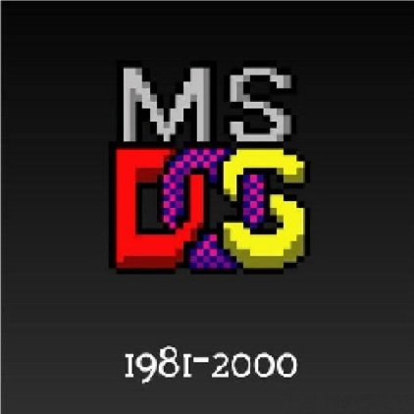
Simple Structure -- MS-DOS
MS-DOS – written to provide the most functionality in the least space
Designed and implemented by few people who had no idea that it would become so popular
Written by Tim Paterson

Slide 177
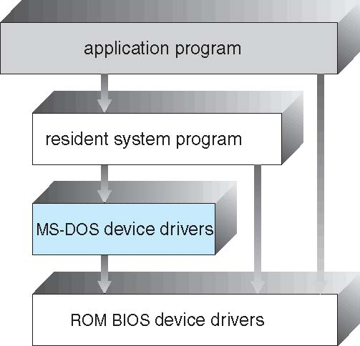
Simple Structure -- MS-DOS
MS-DOS – written to provide the most functionality in the least space
Because of the limited hardware it was build on,
it was Not divided into modules carefully
Although MS-DOS has some structure,
its interfaces and levels of functionality
are not well separated

Slide 178
Simple Structure -- MS-DOS
Development?
Microsoft Disk Operating System
OS for x86-based PCS mostly developed by Microsoft.
Collectively, MS-DOS,
some operating systems attempting to be compatible with MS-DOS, are sometimes referred to as "DOS" (which is also the generic acronym for disk operating system)

Slide 179
Simple Structure -- MS-DOS
Competitors?
It was gradually superseded by OS offering a graphical user interface (GUI),
in various generations of the graphical Microsoft Windows operating system.

Slide 180
Simple Structure -- MS-DOS
Competitors?
Although MS-DOS and PC DOS were initially developed in parallel by Microsoft and IBM,
the two products diverged after twelve years, in 1993, with recognizable differences in compatibility, syntax, and capabilities.

Slide 181
Simple Structure -- MS-DOS
Closure?
MS-DOS went through eight versions, until development ceased in 2000
Versions
MS-DOS 1.x
MS-DOS 2.x
MS-DOS 3.x
MS-DOS 4.0 / MS-DOS 4.x
MS-DOS 5.x
MS-DOS 6.x
MS-DOS 7 (as part of Windows 9x)
Localized versions

Slide 182
Non Simple Structure -- UNIX
UNIX – limited by hardware functionality, the original UNIX operating system had limited structuring.
The UNIX OS consists of two separable parts
Systems programs
The kernel

Slide 183
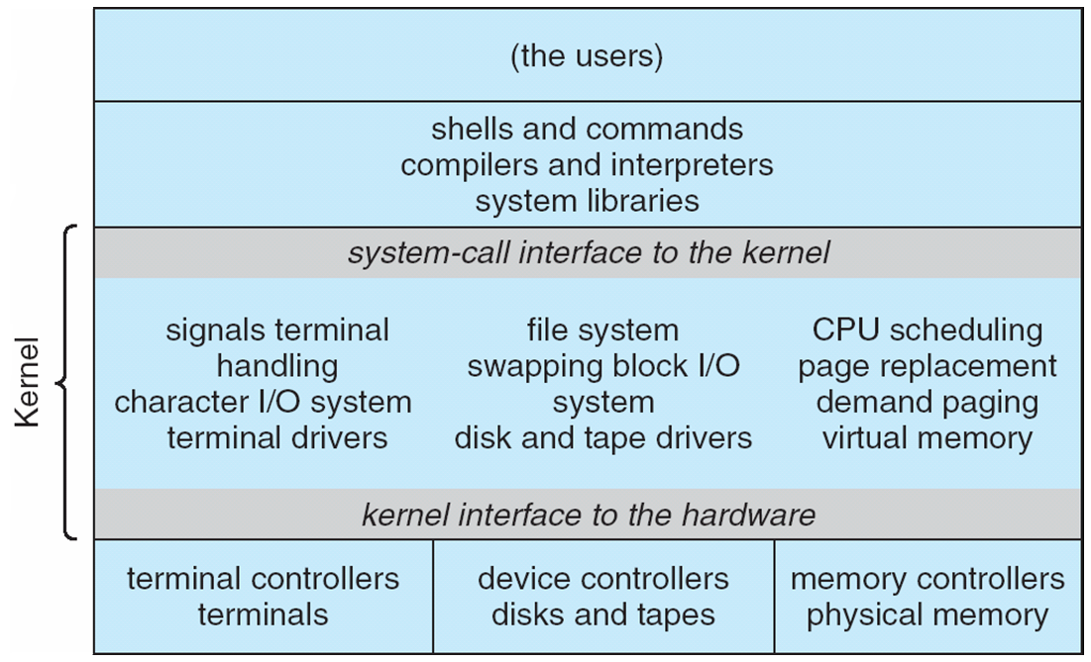
Traditional UNIX System Structure
Beyond simple but not fully layered

Slide 184
Non Simple Structure -- UNIX
The kernel
Consists of everything below the system-call interface and above the physical hardware
Further separated into series of interfaces and device drivers which were added and expanded over the years as UNIX evolved.
.

Slide 185
Non Simple Structure -- UNIX
The kernel
Provides the file system, CPU scheduling, memory management, and other functions; a large number of functions for one level
An enormous amount of functionality to be combined into one level,
This makes UNIX difficult to enhance,
as changes in one level could adversely affect other areas.

Slide 186
UNIX System Structure
New versions of UNIX are designed to use more advanced hardware.
Given proper hardware support,
OS may be broken into pieces
that are smaller and more appropriate than those allowed
by the original MS-DOS or UNIX systems.

Slide 187
UNIX
Unix is a family of multitasking, multiuser computer operating systems that derive from the original AT&T Unix,
Development starting in the 1970s at the Bell Labs research center by Ken Thompson, Dennis Ritchie, and others

Slide 188
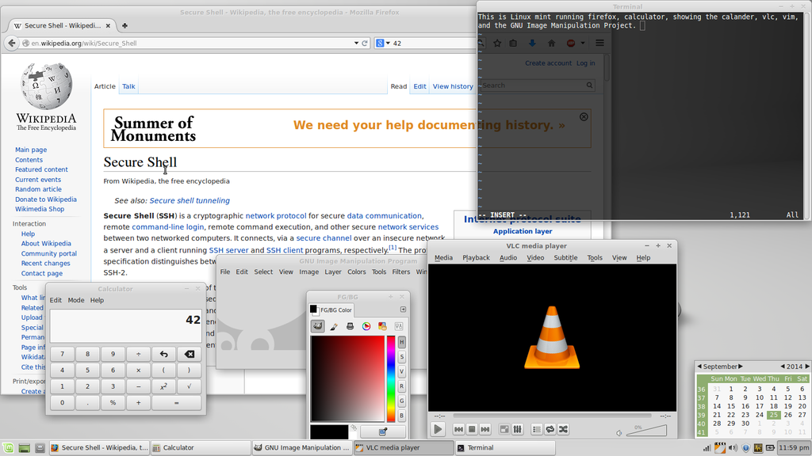
MULTITASKING
Multitasking is the concurrent execution of multiple tasks (also known as processes) over a certain period of time. New tasks can interrupt already started ones before they finish

Slide 189
MULTIUSER

Slide 190
MULTIUSER
Some multi-user operating systems such as Windows versions from the Windows NT family support simultaneous access by multiple users .
For example, via Remote Desktop Connection as well as the Local user
An example is a Unix or Unix-like system where multiple remote users have access (such as via a serial port or Secure Shell) to the Unix shell prompt at the same time.

Slide 191
UNIX
There are many different versions of UNIX, although they share common similarities.
The most popular varieties of UNIX are Sun Solaris, GNU/Linux, and MacOS X.

Slide 192
Some people think Unix and Linux as synonyms, but that's not true.

Slide 193
Linux is the clone of Unix. It has several features similar to Unix, still have some key differences.
Linux is a family of open-source Unix-like operating systems based on the Linux kernel

Slide 194
Difference between Linux and Unix??

Slide 195
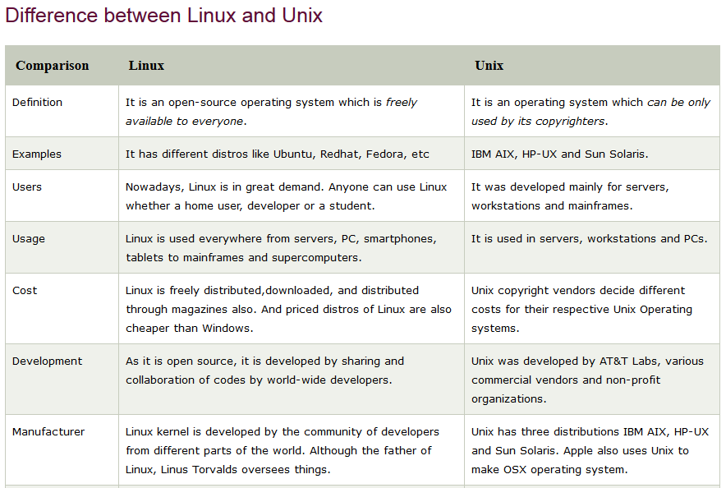
Important

Slide 196
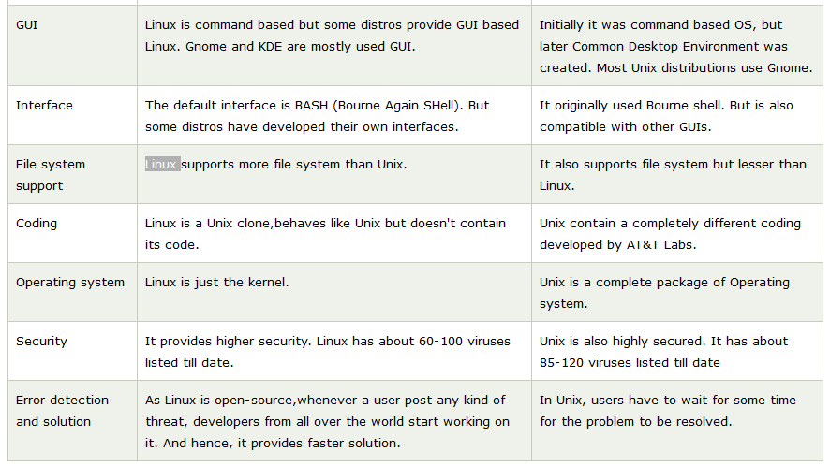

Slide 197
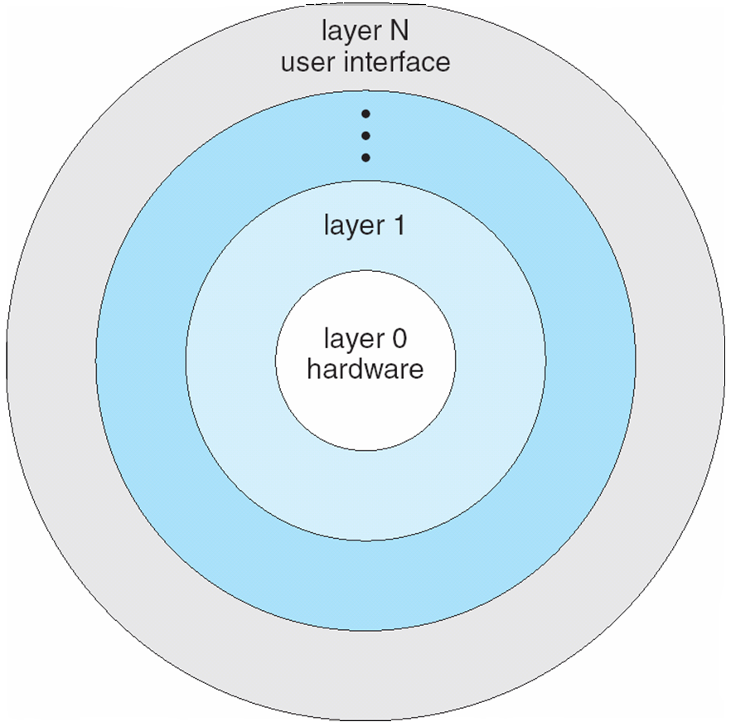
Layered Approach
The operating system is divided
into a number of layers (levels),
each built on top of lower layers.
The bottom layer (layer 0), is the hardware;
The highest (layer N) is the user interface.

Slide 198
Layered Approach
An OS layer say M,
consists of data structures and
a set of routines
that can be invoked by higher layers.
Layer M can invoke operations on lower layers.
With modularity,
layers are selected such that
each uses functions and services of only lower-level layers

Slide 199
Layered Approach
It simplifies debugging and system verification.
The 1st layer can be debugged
without any concern for the rest of the system.
Once the 1st layer is debugged,
its correct functioning can be assumed while
the second layer is being debugged and so on.

Slide 200
Layered Approach
If error arises during debugging of a particular layer,
the error must be on that layer,
because the layers below it are already debugged.

Slide 201
Microkernel System Structure
Moves as much from the kernel into user space
Mach example of microkernel
Mac OS X kernel (Darwin) partly based on Mach
Communication takes place between user modules using message passing

Slide 202
Microkernel System Structure

Slide 203
Comparison-Microkernel System UNIX Kernel

Slide 204
Microkernel System Structure
How?
Remove all non essential components from the kernel and
implementing them as system and user level programs.
Result=Smaller=Micro Kernel

Slide 205
Microkernel System Structure
How?
Microkernels provide
minimal process and memory management, communication facility.
Main fn
Provide a communication facility
between client program and various services that are also running in user space,
Communication provided by Message passing

Slide 206
Microkernel System Structure
When ? Where?
As the UNIX OS expanded, kernel became large and difficult to manage.
In mid 1980s, researchers at Carnegie Mellon University developed an OS called Mach,
that modularizes the kernel using The Microkernel approach.

Slide 207
Microkernel System Structure
Benefits:
Easier to extend a microkernel
All new services added to user space , no modification of the kernel
Easier to port the operating system to new architectures
As no modifications to kernel, changes tend to be fewer, a smaller kernel

Slide 208
Microkernel System Structure
Benefits:
More reliable (less code is running in kernel mode) and More secure
More services running as user rather than kernel,
If a service fails, the rest of the operating system remains untouched.

Slide 209
Microkernel System Structure
Detriments:
Performance overhead of user space to kernel space communication

Slide 210
Linux Kernel
Think about it like this.
The kernel is a busy personal assistant for a powerful executive (the hardware).
It’s the assistant’s job :-
to relay messages and requests (processes) from employees and the public (users) to the executive,
to remember what is stored where (memory), and
to determine who has access to the executive at any given time and for how long.
Courtesy: https://www.redhat.com/en/topics/linux/what-is-the-linux-kernel

Slide 211
Linux Kernel
Linux Kernel a busy personal assistant that
manages all system resources and
that interacts directly with the computer hardware.
The Linux® kernel is
the main component of a Linux operating system (OS) and
is the core interface between a computer’s hardware and its processes.
It communicates between the two, managing resources as efficiently as possible

Slide 212
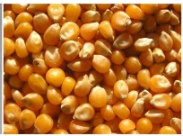
Linux Kernel
The kernel is so named because—
like a seed inside a hard shell
it exists within the OS and
controls all the major functions of the hardware

Slide 213
Linux Kernel
We need much more than this kernel
to produce a full operating system.
The Linux kernel
forms the core of the Linux project, but
other components make up the complete Linux operating system

Slide 214
Linux Kernel
Linux kernel is composed
entirely of code written from scratch specifically for the Linux project,
Whereas the Linux system includes
a multitude of components some written from scratch
other borrowed from other development projects and
others created in collaboration with other teams.

Slide 215
Linux Kernel
The kernel, if implemented properly,
is invisible to the user,
working in its own little world known as kernel space,
where it allocates memory and
keeps track of where everything is stored.
What the user sees—like web browsers and files—are known as the user space.
These applications interact with the kernel
through a system call interface (SCI).
Courtesy: https://www.redhat.com/en/topics/linux/what-is-the-linux-kernel

Slide 216
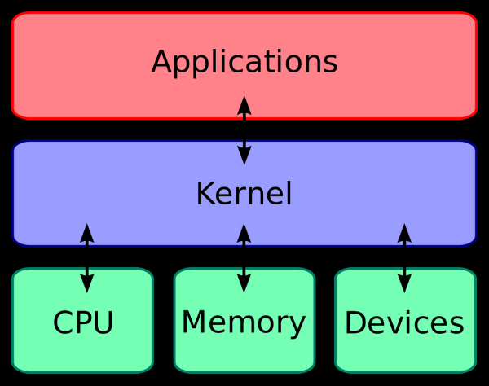
Where the kernel fits within the OS?
To put the kernel in context, you can think of a Linux machine as having 3 layers:
The hardware
The Linux kernel: The core of the OS. (See? It’s right in the middle.) It’s software residing in memory that tells the CPU what to do.
User processes: These are the running programs that the kernel manages.
User processes are what collectively make up user space.
The kernel also allows these processes and servers to communicate with each other (known as inter-process communication, or IPC).
Courtesy: https://www.redhat.com/en/topics/linux/what-is-the-linux-kernel

Slide 217
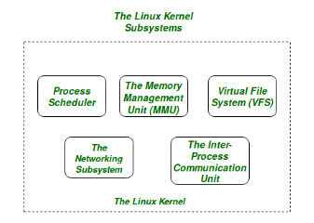
Linux Kernel
The Core Subsystems of the Linux Kernel are as follows:
The Process Scheduler/ Process management
The Memory Management Unit (MMU)
The Virtual File System (VFS) /File management
The Networking Unit
Inter-Process Communication Unit
Device management/ I/O management

Slide 218


Slide 219

Linux Kernel
It is often mistaken that Linus Torvalds has developed Linux OS,
but actually he is only responsible for development of Linux kernel.
Complete Linux system = Kernel + GNU system utilities and libraries + other management scripts + installation scripts.

Slide 220
What is Shell?
A shell is special user program which provide an interface to user to use operating system services.
Shell accept human readable commands from user and convert them into something which kernel can understand.

Slide 221
What is Shell?
It is a command language interpreter that execute commands read from input devices such as keyboards or from files.
The shell gets started when the user logs in or start the terminal.

Slide 222

What is Shell?
It is named a shell because it is the outermost layer around the operating system.

Slide 223
What is Shell?
Shell is broadly classified into two categories-
Command Line Shell
Graphical shell

Slide 224
Command Line Shell
Shell can be accessed by user using a command line interface.
A special program called
Terminal in linux/macOS or
Command Prompt in Windows OS
is provided to type in the human readable commands such as “cat”, “ls” etc. for execution. The result is then displayed on the terminal to the user.

Slide 225

Command Line Shell
A terminal in Ubuntu 16.4 system looks like this –

Slide 226
Command Line Shell
Working with command line shell is bit difficult for the beginners because it’s hard to memorize so many commands.
It is very powerful, it allows user to store commands in a file and execute them together. This way any repetitive task can be easily automated.
These files are usually called
Batch files in Windows and
Shell Scripts in Linux/macOS systems.

Slide 227
Graphical Shells
Provide means for manipulating programs based on graphical user interface (GUI),
by allowing for operations such as opening, closing, moving and resizing windows, as well as switching focus between windows.
Window OS or Ubuntu OS can be considered as good example which provide GUI to user for interacting with program.
User do not need to type in command for every actions.

Slide 228
CLI vs GUI shells
Command-line shells require the user
to be familiar with commands and
their calling syntax, and
to understand concepts about the shell-specific scripting language
Graphical shells place
a low burden on beginners and are easy to use.
Since they also come with certain disadvantages, most GUI-enabled operating systems also provide CLI shells.

Slide 229
Shell Prompt
The prompt, $, which is called the command prompt, is issued by the shell.
While the prompt is displayed, you can type a command.
Shell reads your input after you press Enter.
It determines the command you want to be executed by looking at the first word of your input. A word is an unbroken set of characters. Spaces and tabs separate words.

Slide 230
FINDING OUT YOUR SHELL
When you are provided with a UNIX account, the system administrator chooses a shell for you.
To find out which shell was chosen for you, look at your prompt.
If you have a $ prompt, you’re probably in a Bash, Bourne or a Korn shell.
If you have a % prompt, you’re probably in a C shell.

Slide 231

FINDING OUT YOUR SHELL
Using the Echo command

Slide 232
List all the shells on your PC?
Using the Cat command

Slide 233

List all the shells on your PC?
The list of all the shells which are currently installed in our Linux system is stored in the ‘shells’ file which is present in /etc folder of the system.
It has read-only access by default and is modified automatically whenever we install a new shell in our system.

Slide 234
/etc — Configuration Files
The /etc directory contains configuration files, which can generally be edited by hand in a text editor.
Note that the /etc/ directory contains system-wide configuration files
User-specific configuration files are located in each user’s home directory.

Slide 235

List all the shells on your PC?
The cat command displays the various installed shells along with their installation paths.

Slide 236

Change the shell
Using chsh Utility
chsh is the utility to change a user’s login shell. chsh provides the -s option to change the user’s shell.

Slide 237

Shells
There are several shells are available for Linux systems.
Each shell does the same job but understand different commands and provide different built in functions.

Slide 238
Shell Types
In UNIX there are two major types of shells:
The Bourne shell.
If you are using a Bourne-type shell, the default prompt is the $ character.
The C shell.
If you are using a C-type shell, the default prompt is the % character.
https://www.tutorialspoint.com/unix/unix-what-is-shell.htm

Slide 239
The Bourne Shell
The original UNIX shell written in the mid-1970s by Stephen R. Bourne while he was at AT&T Bell Labs in New Jersey.
Original UNIX shell-The Bourne shell was the first shell to appear on UNIX systems, thus it is referred to as "the shell".
Denoted as sh
It is faster and more preferred.
https://www.tutorialspoint.com/unix/unix-what-is-shell.htm

Slide 240
The Bourne Shell
It lacks features for interactive use like the ability to recall previous commands.
It also lacks built-in arithmetic and logical expression handling.
It is default shell for Solaris OS.

Slide 241
CSH (C SHell)
The C Shell
Denoted as csh
Bill Joy created it at the University of California at Berkeley.
It incorporated features such as aliases and command history.
It includes helpful programming features like built-in arithmetic
C-like expression syntax-shell syntax and usage are very similar to the C programming language.

Slide 242
Shell Types
There are again various subcategories for Bourne Shell which are listed as follows −
Bourne shell ( sh)
Korn shell ( ksh)
Bourne Again shell ( bash)
POSIX shell
The different C-type shells follow −
C shell ( csh)
TENEX/TOPS C shell ( tcsh)
https://www.tutorialspoint.com/unix/unix-what-is-shell.htm

Slide 243

The Korn Shell
It is denoted as ksh
It Was written by David Korn at AT&T Bell Labs.
It is a superset of the Bourne shell. So it supports everything in the Bourne shell.

Slide 244
The Korn Shell
It has interactive features.
It includes features like built-in arithmetic and C-like arrays, functions, and string-manipulation facilities.
It is faster than C shell. It is compatible with script written for C shell.
The Korn Shell also was the base for the POSIX Shell standard specifications etc.

Slide 245
BASH
BASH= Bourne Again Shell
The shell's name is an acronym for Bourne Again Shell,
A pun on the name of the Bourne shell that it replaces and
The notion of being "born again".
https://en.wikipedia.org/wiki/Bash_(Unix_shell)#:~:text=Bash%20is%20a%20Unix%20shell,ported%20to%20Linux%2C%20alongside%20GCC.

Slide 246

GNU Bourne-Again Shell
The Bash command syntax is a superset of the Bourne shell command syntax.
Bash command syntax includes ideas drawn from the KornShell (ksh) and the C shell (csh) such as command line editing, command history (history command),the directory stack, and POSIX command substitution syntax

Slide 247
GNU Bourne-Again Shell
Denoted as bash
It is compatible to the Bourne shell.
It includes features from Korn and Bourne shell.
It is most widely used shell in Linux systems.
It is used as default login shell in Linux systems and in macOS. It can also be installed on Windows OS.

Slide 248
GNU ?

Slide 249
GNU ?
GNU is an operating system and also an extensive collection of utility programmes wholly free software and also the project within which the free software concept originated
GNU is a recursive acronym for "GNU's Not Unix!“
Chosen because GNU's design is Unix-like, but differs from Unix by being free software and containing no Unix code.

Slide 250
Shell Scripting
Usually shells are interactive that mean,
they accept command as input from users and execute them.
to execute a bunch of commands routinely,
so we have to type in all commands each time in terminal.

Slide 251
Shell Scripting
As shell can also take commands
as input from file we can write these commands in a file
can execute them in shell to avoid this repetitive work.
These files are called Shell Scripts or Shell Programs.
Shell scripts are similar to the batch file in MS-DOS.
Each shell script is saved with .sh file extension eg. myscript.sh

Slide 252
Shell Scripting
A shell script have syntax just like any other programming language.
A shell script comprises following elements –
Shell Keywords – if, else, break etc.
Shell commands – cd, ls, echo, pwd, touch etc.
Functions
Control flow – if..then..else, case and shell loops etc.

Slide 253
The Shell Definition Line
The shell definition line tells the system
what shell should be used to interpret the script's commands, and
where the program (shell) is located.
The shell definition line tells the system to use the Korn Shell when executing this script.
(#!/bin/ksh)

Slide 254
Shell Script Comments
Comments, or non-command code,
In a shell script, Comments begin with the # (pound) character

Slide 255
Permissions for script
Before you can run the script, you need to make the shell script file, an executable by using the UNIX chmod command.

Slide 256
Permissions for script
The following command will allow only the user (owner) of the script to execute it:
$ chmod u+x script1
If you wanted to allow everyone (all) to execute the script, you would use this command:
$ chmod a+x script1

Slide 257
Executing script
After the script file has been made an executable with the chmod command, you can run the script in a new shell by giving the path to the script:
$ ./script1
This (./) would be the path to script1 if you are in the same directory as the script.
If you were in a different directory than the script, you could use one of the following commands to run it:
$ /home/student1/script1 or $ /bin/ksh /home/student1/script1

Slide 258
Executing script
On some online portals, Execute it as
$ sh script1.sh

Slide 259
Sample program
vi hello.sh
To go into edit mode:
press ESC and type I
To save a file
press ESC and type :w fileName
To save a file and quit:
press ESC and type :wq
Or
press ESC and type :x
Save and close the file.
You can run the script as follows:
./hello.sh
Sample outputs:
bash: ./hello.sh: Permission denied
Type chmod u+x hello.sh
And execute the program again

Slide 260
Chmod command

Slide 261
Chmod command
The 'chmod command is used to change the access permissions of a file. The syntax is as follows:
chmod ugo+rwx filename Where,
u : Users
g : Groups
o : Others
+ : Adds the permission
- : Removes the permission
= : Overwrites current permissions
r : Read permission
w : Write permission
x : Execute permission

Slide 262
Displaying Output
Two methods for displaying output to standard output:
echo "Text Line 1"
The print command is the replacement for the echo command.
You can use the print command when you are writing shell scripts because
it is more powerful than the echo command, and
its syntax has been standardized on multiple operating systems.

Slide 263
Echo command
echo - display a line of text.
Example-2:
To print value of x, where x=10.
$ echo $x
output: 10

Slide 264


Echo command
To display a line of text
test2.sh-
Output-

Slide 265


Echo command
Using double quotes with echo
test2.sh-
Output-

Slide 266

Echo command
Using double quotes with echo
That the use of double quotes (") characters affect how spaces and TAB characters are treated, for example:

Slide 267

Read command
To read input from the user
test2.sh-

Slide 268

Read command
To read input from the user
test2.sh-
Output-

Slide 269
How to define variables
We can define a variable by using the syntax variable_name=value.
To get the value of the variable, add $ before the variable.

Slide 270
Arithmetic expression
Arithmetic expansion allows the evaluation of an arithmetic expression and the substitution of the result.
The format for arithmetic expansion is:
$((expression))
Reading man bash says that the old format:
$[expression]
is deprecated and will be removed.
Otherwise they should be equivalent.

Slide 271
Shell Script to Add Two Integers
#!/bin/bash
# Calculate the sum of two integers with pre initialize values
# in a shell script
a=10
b=20
sum=$(( $a + $b ))
echo $sum

Slide 272

Shell Script to Add Two Integers

Slide 273

Arithmetic Operators

Slide 274

Relational Operators

Slide 275
Shell Script –Using Decision constructs
Syntax
if [ expression ]
then
Statement(s) to be executed if expression is true
else
Statement(s) to be executed if expression is not true
fi

Slide 276
Conditional Expressions
It is very important to understand that all the conditional expressions should be inside square braces with spaces around them,
For example
[ $a == $b ] is correct whereas,
[$a==$b] is incorrect.

Slide 277
Conditional Expressions
It is very important to understand that all the conditional expressions should be placed inside square braces with spaces around them.
For example,
[ $a <= $b ] is correct whereas,
[$a <= $b] is incorrect.

Slide 278
Conditional Expressions
-lt is Less than which is used for condition checking
< is used for Reading input from the files.
The statement [ $num < 10 ] is just syntactic sugar for the command test $num < 10, which means:
Run the command test with one parameter (the content of the shell variable num), and
associate the standard input of this invocation with a file named 10

Slide 279


Shell Script –Using Decision constructs
Example-
Output-

Slide 280

Shell Script to check if a number is even or odd
expr is an external program used by Bourne shell.
It uses expr external program with the help of backtick.
The backtick(`) is actually called command substitution.

Slide 281

Shell Script to check if a number is even or odd
Output-
expr is an external program used by Bourne shell.
It uses expr external program with the help of backtick.
The backtick(`) is actually called command substitution.

Slide 282

Shell Script to check if a number is even or odd

Slide 283
Shell Script to calculate hra and ta

Slide 284

Shell Script to calculate hra and ta
expr is an external program used by Bourne shell.
It uses expr external program with the help of backtick.
The backtick(`) is actually called command substitution.

Slide 285

Shell Script to calculate hra and ta
Output-

Slide 286
The backslash (\) character is used to mark these special characters so that they are not interpreted by the shell, but passed on to the command being run (for example, echo).

Slide 287

For Loop Syntax
condition1 indicates initialization,
cond2 indicates condition and cond3 indicates updation.

Slide 288


For Loop Eg
O/P-

Slide 289
System Boot

Slide 290
System Boot
The boot process is something that
happens every time
you turn your computer on.
You don’t really see it,
because it happens so fast.
You press the power button,
come back a few minutes later and
Windows XP, or Windows 10, or whatever Operating System you use
is all loaded.

Slide 291

System Boot

Slide 292
System Boot- The working
The CPU initializes itself
after the power in the computer is first turned on.
This is done by triggering a series of clock ticks
that are generated by the system clock.

Slide 293
System Boot- The working
After this, the CPU looks for the system’s ROM BIOS
This first instruction is stored in the ROM BIOS and
it instructs the system to
run POST (Power On Self Test)
in a memory address that is predetermined.
Since ROM is read only,
it cannot be infected by a computer virus.

Slide 294
System Boot- The working
POST first checks
the BIOS chip and
then the CMOS RAM.
If no battery failure is detected by POST,
then it continues to initialize the CPU.
POST also checks
the hardware devices,
secondary storage devices such as hard drives, ports etc.
And other hardware devices such as the mouse and keyboard.
This is done to make sure they are working properly.
After POST makes sure that all the components are working properly, then the BIOS start Boot Strap program.

Slide 295

Post method

Slide 296

Courtesy : http://www.c-jump.com/CIS24/Slides/Booting/Booting.html

Slide 297
System Boot- The working
For most computers, Boot Strap is stored in BIOS ROM.
Changing the Bootstrap code requires changing the ROM hardware chips.
Alternative:
A tiny Bootstrap loader program is stored in the ROM,
whose only job is to bring in a full bootstrap program from the disk.
The full bootstrap pgm can be changed easily.

Slide 298

System Boot- The working
The Bootstrap pgm
is stored in a partition called the boot blocks ,
at a fixed location on the disk.
A disk that has a boot partition
is called a Boot Disk or System Disk.

Slide 299
System Boot- The working
The Bootstrap program is loaded into memory and
starts its execution.
The bootstrap program
finds the OS kernel on disk,
loads that Kernel into memory and
jumps to an initial address
to begin the OS execution.

Slide 300

Master Boot Record
The Master Boot Record (MBR) is the information which is in the first sector of any hard disk.
It holds information about GRUB (or LILO in old systems).

Slide 301
init
This is the last step of the booting process.
It decides the run level by looking at the / etc / inittab file.
The initial state of the operating system is decided by the run level.

Slide 302
init
Following are the run levels of Operating System:
Level 0 - System Halt 1 - Single user mode 2 - Multiuser, without NFS(Network File System) 3 - full multiuser mode 4 - unused 5 - Full multiuser mode with network and X display manager(X11) 6 - Reboot
We would set the default run level to either 3 or 5.

Slide 303
The step after it is to
Start up various daemons that support networking and other services.
X server daemon manages display, keyboard, and mouse.
You can see a Graphical Interface and
A login screen is displayed during X server daemon is started.

Slide 304
Daemons are processes that run unattended.
They are constantly in the background and are available at all times.
Daemons are usually started when the system starts, and they run until the system stops.

Slide 305
System Boot
When power is initialized on system,
execution starts at a fixed memory location,
Firmware ROM used to hold initial boot code
Operating system must be
made available to hardware
so hardware can start it

Slide 306

System Boot
Sometimes two-step process where
Boot block at fixed location loaded by ROM code,
which loads bootstrap program from disk
Then loader continues with its job

Slide 307
System Boot
Bootstrap loader
Small piece of code,
stored in ROM or EEPROM (electrically erasable programmable read-only memory)
locates the kernel,
loads it into memory, and
starts it

Slide 308
System Boot
Common bootstrap loader,
GRUB, (the GRand Unified Bootloader)
allows selection of kernel from
multiple disks,
versions,
kernel options
Kernel loads and
system is then running

Slide 309
Failure during boot
If the computer cannot boot, we will get a boot failure error.
This error indicates that the computer is not passing POST or
a device in the computer, such as the hard drive or memory, has failed.
You may also hear a beep code to identify which hardware is failing during the POST.
An error message or blue screen may show on the screen as operating system files cannot be loaded, due to not being found or being corrupt.

Slide 310
What is the name given to the process of initializing a microcomputer with its operating system?
(a) Cold booting
(b) Booting
(c) Warm booting
(d) Boot recording
(e) None of the above

Slide 311
What is the name given to the process of initializing a microcomputer with its operating system?
(a) Cold booting
(b) Booting (Ans)
(c) Warm booting
(d) Boot recording
(e) None of the above

Slide 312
Cold Boot-
To perform a cold boot (also called a "hard boot") means to start up a computer that is turned off.
Warm Boot-
It is often used in contrast to a cold boot, which refers to restarting a computer once it has been turned on.
While a warm boot and cold boot are similar,
a cold boot performs a more complete reset of the system than a warm boot.

Slide 313
Warm Boot-
If the computer hangs because of some reason while working, and demands to be restarted to make it working.
The process of reset/restart of the computer system is called as warm booting.
It is done with the help of reset button or keys (Ctrl+Alt+Del).

Slide 314


Slide 315
Consider the following statements :
UGC-NET | UGC-NET CS 2017 Nov – III | Question 73
(a) UNIX provides three types of permissions * Read * Write * Execute (b) UNIX provides three sets of permissions * permission for owner * permission for group * permission for others
Which of the above statement/s is/are true ?
(A) only (a) (B) only (b) (C) Both (a) and (b) (D) Neither (a) nor (b)

Slide 316
Consider the following statements :
UGC-NET | UGC-NET CS 2017 Nov – III | Question 73
(a) UNIX provides three types of permissions * Read * Write * Execute (b) UNIX provides three sets of permissions * permission for owner * permission for group * permission for others Which of the above statement/s is/are true ?
(A) only (a) (B) only (b) (C) Both (a) and (b) (D) Neither (a) nor (b) Answer: (C) Explanation: UNIX provides Read, Write and Execute permisision on files UNIX provides three sets of permissions
permission for owner
permission for group
permission for others

Slide 317
UGC-NET | UGC NET CS 2015 Dec – III | Question 56
In Unix, the command to enable execution permission for file “mylife” by all is ____________. (A) Chmod ugo + X myfile (B) Chmod a + X myfile (C) Chmod + X myfile (D) All of the above

Slide 318
UGC-NET | UGC NET CS 2015 Dec – III | Question 56
In Unix, the command to enable execution permission for file “mylife” by all is ____________. (A) Chmod ugo + X myfile (B) Chmod a + X myfile (C) Chmod + X myfile (D) All of the above Answer: (D) Explanation: In Unix, the command to enable execution permission for file “mylife” by all are: Chmod + X myfile Chmod a + X myfile Chmod ugo + X myfile So, option (D) is correct.

Slide 319
System Calls

Slide 320
System Calls
Provide the Interface between a process and the OS

Slide 321
System Calls
WHEN?
System calls are usually made when a process in user mode requires access to a resource.
Then it requests the kernel to provide the resource via a system call.

Slide 322
System Calls
WHAT Resources?

Slide 323
System Calls
WHEN?
System calls are required in the following situations −
If a file system requires the creation or deletion of files.
Reading and writing from files also require a system call.
Creation and management of new processes.
Network connections also require system calls. This includes sending and receiving packets.
Access to a hardware devices such as a printer, scanner etc. requires a system call.

Slide 324

System Calls
The processes execute normally in the user mode until a system call interrupts this.
Then the system call is executed on a priority basis in the kernel mode.
After the execution of the system call, the control returns to the user mode
Execution of user processes can be resumed.

Slide 325
System Calls
Generally available as Assembly language instructions.
Certain systems allow system calls to be made directly from a higher level language program,
In this case, they resemble predefined functions or subroutine calls

Slide 326
System Calls
Languages like C,C++, Perl have been defined to replace Assembly language for system programming.
They allow system calls to be made directly from programs.
Unix system call may be invoked directly from C or C++ program.

Slide 327

Example of System Calls
System call sequence to copy the contents of one file to another file

Slide 328
Example of System Calls
System call sequence to copy the contents of one file to another file
Even simple programs may make heavy use of the operating system.
Most users never see this level of detail.

Slide 329

System Call Implementation
Typically, a number is associated with each system call
System-call interface maintains a table indexed according to these numbers
The system call interface
invokes the intended system call in OS kernel and
returns status of the system call and any return values

Slide 330
System Call Implementation
The caller need know nothing about how the system call is implemented
Just needs to obey API and understand what OS will do as a result of call
Most details of OS interface hidden from programmer by API
Managed by run-time support library (set of functions built into libraries included with compiler)

Slide 331
API – System Call – OS Relationship

Slide 332
System Call Parameter Passing
System Calls occur in different ways
Often, more information is required than simply identity of desired system call
Exact type and amount of information vary according to OS and call
Eg- To get input,
we need to specify file or device to use as the source and
the address and length of the memory buffer into which the input should be read.

Slide 333

Example of Standard API

Slide 334
System Call Parameter Passing
Three general methods used to pass parameters to the OS
Simplest: pass the parameters in registers
In some cases, may be more parameters than registers
Parameters stored in a block, or table, in memory, and address of block passed as a parameter in a register
This approach taken by Linux and Solaris
Parameters placed, or pushed, onto the stack by the program and popped off the stack by the operating system
Block and stack methods do not limit the number or length of parameters being passed

Slide 335

Parameter Passing via Table

Slide 336

Types of System Calls

Slide 337
Types of System Calls
Process control
create process, terminate process
end, abort
load, execute
get process attributes, set process attributes
wait for time
wait event, signal event
allocate and free memory
Dump memory if error
Debugger for determining bugs, single step execution
Locks for managing access to shared data between processes

Slide 338
Types of System Calls
File management
create file, delete file
open, close file
read, write, reposition
get and set file attributes

Slide 339
Types of System Calls
Device management
request device, release device
read, write, reposition
get device attributes, set device attributes
logically attach or detach devices

Slide 340
Types of System Calls (Cont.)
Information maintenance
get time or date, set time or date
get system data, set system data
get and set process (process id), file, or device attributes

Slide 341
Types of System Calls (Cont.)
Communications
create, delete communication connection
send, receive messages
If message passing model to host name or process name
From client to server
Shared-memory model create and gain access to memory regions
transfer status information
attach and detach remote devices

Slide 342
Types of System Calls (Cont.)
Protection
Control access to resources
Get and set permissions
Allow and deny user access

Slide 343

Examples of Windows and Unix System Calls

Slide 344

Layered File System

Slide 345
Device Drivers
Device drivers manage I/O devices at the I/O control layer
Device driver controls the physical device
The I/O control consists of
device drivers and
interrupt handlers
to transfer information between the main memory and the disk system.

Slide 346
Device Drivers
A device driver
can be thought of as a translator.
Its input consists of high level commands such as “retrieve block 123”
Given commands like “read drive1, cylinder 72, track 2, sector 10, into memory location 1060”
outputs low-level hardware specific commands to hardware controller

Slide 347

Device Drivers
Its output consists of
low level hardware specific instructions
that are used by the hardware controller
which interfaces I/O device to the rest of the system.
The device driver
writes specific bit patterns
to special locations in the I/o controller’s memory
to tell the controller on which device location to act and
what actions to take.

Slide 348
Device Drivers
Device drivers are
software modules that can be plugged into an OS to handle a particular device.
Operating System takes help from
device drivers to handle all I/O devices.
Courtesy:https://www.tutorialspoint.com/operating_system/os_io_hardware.htm

Slide 349

Device Controllers
The Device Controller works like
an interface between a device and a device driver.
There is always a device controller and a device driver
for each device to communicate with the Operating Systems.
Courtesy:https://www.tutorialspoint.com/operating_system/os_io_hardware.htm

Slide 350
Device Controllers
I/O units (Keyboard, mouse, printer, etc.) typically consist of
a mechanical component and
an electronic component
where electronic component is called the device controller.
Courtesy:https://www.tutorialspoint.com/operating_system/os_io_hardware.htm

Slide 351
Device Controllers
A Electrical component/device controller controls the device
May be able to handle multiple devices.
May be more than one controller per mechanical component. (Eg- Hard drive)
Controller’s Tasks-
Convert serial bit stream to block of bytes,
Perform error correction as necessary
Make device available to main memory
Courtesy:https://www.tutorialspoint.com/operating_system/os_io_hardware.htm

